Slide 1
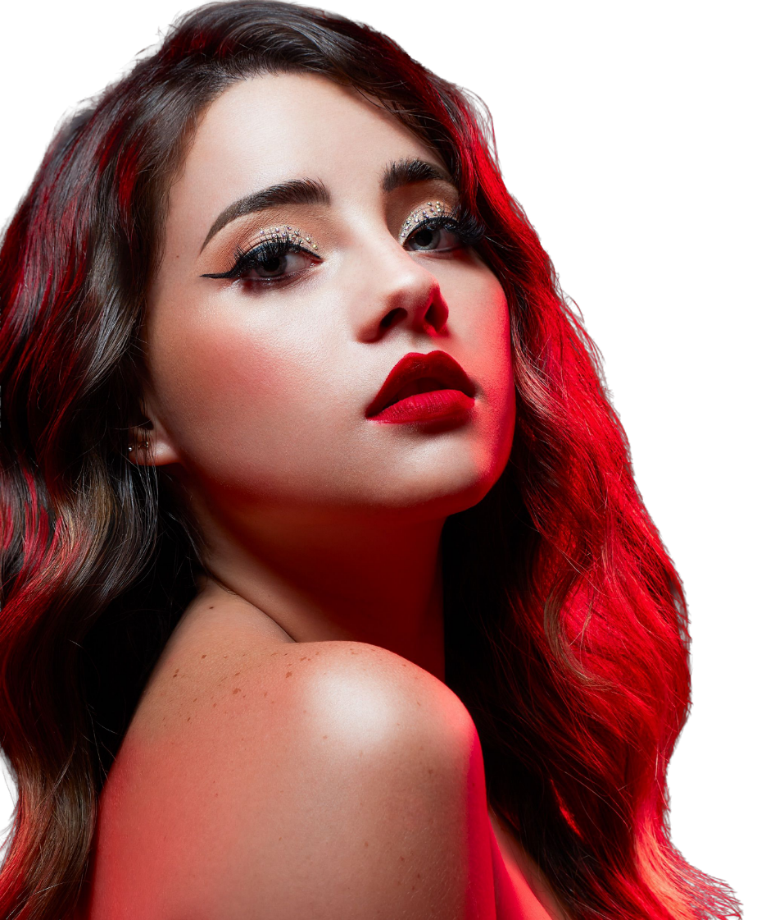
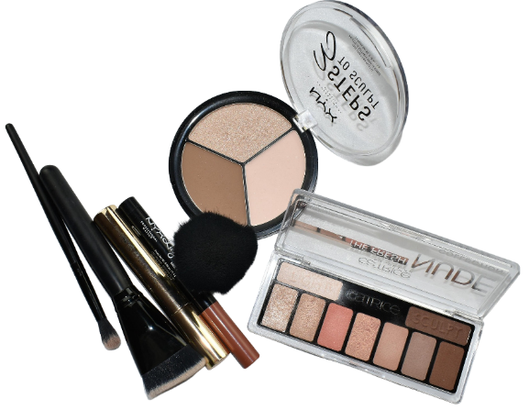
Everyday
Makeup Playbook
Classic | Fashion | Trends
DAILY INSPIRATION HUB / dailyinspirationhub.com / @dailyinspirationhubs
Everyday makeup that looks like you
(Part-03)
Glow Beauty | Daily Inspiration Hubdaily | inspirationhub.com

Slide 2
CONTENTS
What's Inside
01
The Purpose of Makeup
05
Skin prep
Why we wear makeup & what it does
Morning & night routines for healthy skin
02
Skin + Look
06
Makeup Application Steps
Styles, skin classifications & care
Brows, eyes, shadow & liner techniques
03
Build my KIT
07
Makeup Looks and Skin Types
The importance of bottom makeup
Take off formal dress and ornaments
04
Build the base
An introduction to a dresser
Glow Beauty | Daily Inspiration Hubdaily | inspirationhub.com

Slide 3
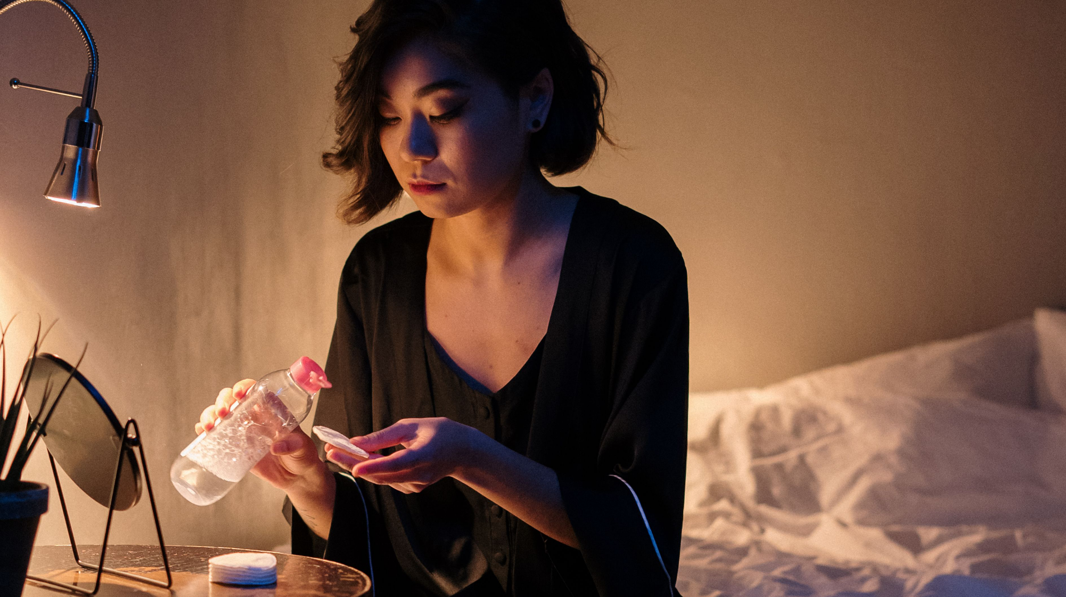
Dissolve first. Cleanse second. Moisturize last.
PART SEVEN
Take it off
Let the formula loosen the makeup. Keep your hands light and your skin calm.
Pick the formula first; technique comes next.
Glow Beauty | Daily Inspiration Hubdaily | inspirationhub.com

Slide 4

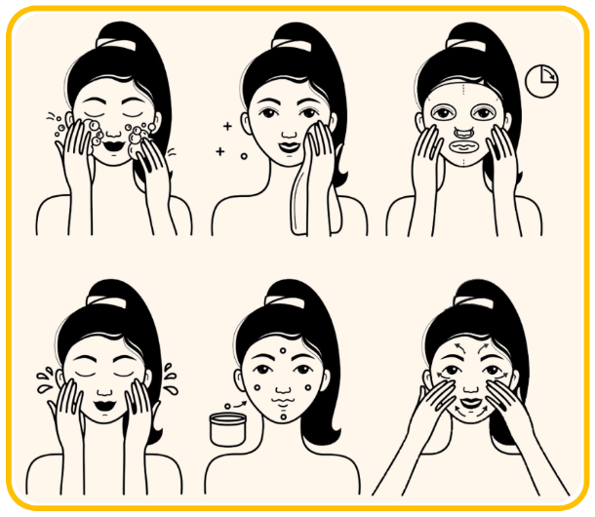
07 / TAKE IT OFF
Six moves to clean skin
NIGHT
The goal is clean, comfortable skin, not a scrubbed-tight feeling.
Removal is about dissolving, not scrubbing. Switch pads when they get dry.
01
Prep first
Wash hands and tie hair back.
CHAPTER ROADMAP
02
Eyes + lips
Press, pause, then wipe.
03
Break down base
Melt long-wear layers first.
04
Cleanse
Use lukewarm water and cleanser.
05
Rinse clean
Check hairline, nose, and jaw.
06
Seal
Moisturize while slightly damp.
Glow Beauty | Daily Inspiration Hubdaily | inspirationhub.com

Slide 5
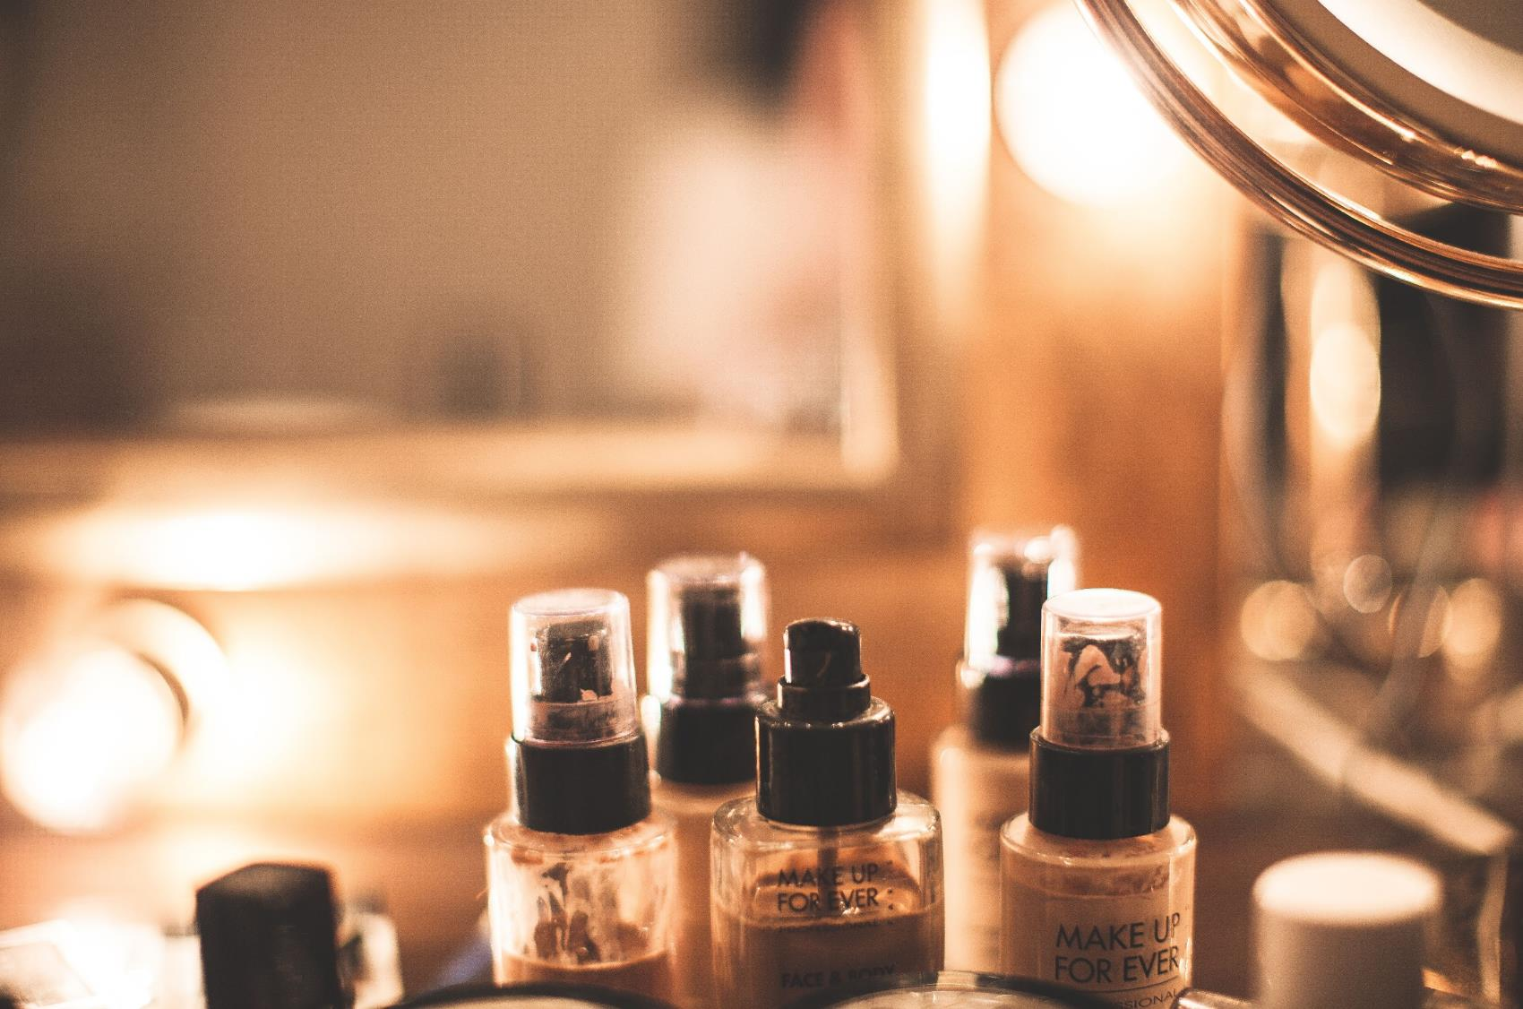
07 / TAKE IT OFF
Ten things are enough
NIGHT
Set the kit up before you start so you never reach for a dirty towel.
Ten things are enough
Set the kit up before you start so you never reach for a dirty towel.
01 Hair tie or clips
06 ye + lip remover
THE BEGINNER KIT
02 Clean hands
07 Gentle cleanser
03 Pads or cloth
08 Cotton swabs
04 Micellar water
09 Soft clean towel
05 Oil or balm
10 Basic moisturizer
Wash reusable cloths after every use and let them dry fully.
Glow Beauty | Daily Inspiration Hubdaily | inspirationhub.com

Slide 6
07 / TAKE IT OFF
Three remover families
NIGHT
Pick the formula first; technique comes next.
01
MICELLAR
Light makeup + quick fixes.
MATCH IT
CHOOSE
THE FORMULA
Light look: micellar water
Full base: oil or balm
Waterproof eyes: bi-phase first
Stop if it stings or reddens
02
OIL + BALM
Base + long-wear makeup.
03
BI-PHASE
Waterproof eyes + long-wear lips.
Pick the formula first; technique comes next.
Glow Beauty | Daily Inspiration Hubdaily | inspirationhub.com

Slide 7
07 / TAKE IT OFF
Match the remover to the wear
NIGHT
MATCH THE WEAR
01
02
03
04
LIGHT
Micellar water or a gentle cleanser may be enough.
EVERYDAY
Use balm or oil, then rinse clean.
WATERPROOF
Use eye remover first and give it time.
FULL GLAM
Remove by area, then do a gentle second cleanse.
MATCH
THE
WEAR
Do not drag one dry pad across the whole face.
Glow Beauty | Daily Inspiration Hubdaily | inspirationhub.com

Slide 8
07 / TAKE IT OFF
Clean should still feel comfortable
NIGHT
A remover should lift makeup without leaving your face hot, tight, or stingy.
A remover should lift makeup without leaving your face hot, tight, or stingy.
FORMULA CHECK
Dry or sensitive: choose cushion and less rubbing.
Oily skin: remove wear, but do not keep washing.
Fragrance is not cleansing power; switch if it bothers you.
SKIN COMFORT
REMOVAL METHOD
Dissolve first, wipe second
Pressure does not make remover work faster. Give the formula a moment, then move in one direction.
Note:
Patch test new products. Stop and rinse if the eye area stings, reddens, or waters.
Result: makeup is gone and skin still feels calm.
Glow Beauty | Daily Inspiration Hubdaily | inspirationhub.com

Slide 9
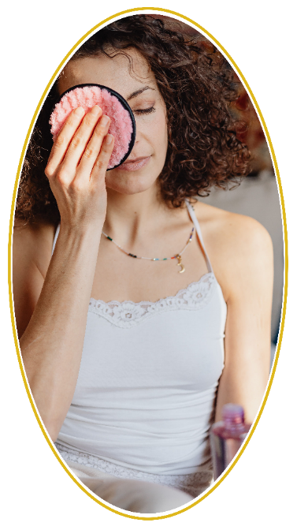
07 / TAKE IT OFF
The five-minute reset
NIGHT
Clean and comfortable is enough; skin should not feel stripped.
Do not scrub until your lashes surrender. Dissolve first, cleanse second, moisturize last.
01
Break down
Hold remover on eyes and lips for about 10 seconds.
FIVE-MINUTE
02
Wipe gently
Swipe one way; do not rub back and forth.
03
Cleanse
Wash the face with a gentle cleanser.
04
Rinse
Use lukewarm water and pat dry.
05
Seal
Moisturize while skin is slightly damp.
Glow Beauty | Daily Inspiration Hubdaily | inspirationhub.com

Slide 10
07 / TAKE IT OFF
Press, pause, then wipe
NIGHT
EYES 01.
The eye area needs time, not pressure. Keep the eyelid closed and let the pad stay wet.
EYES 01
PRODUCT + HOW
EYES
Remove contact lenses before taking eye makeup off.
Saturate the pad, close the eye, and pause.
Wipe down and outward with the lashes.
Result: a clean lash line without tugging the lid.
Note:
Keep remover out of the eye. Rinse and stop if symptoms persist.
Glow Beauty | Daily Inspiration Hubdaily | inspirationhub.com

Slide 11
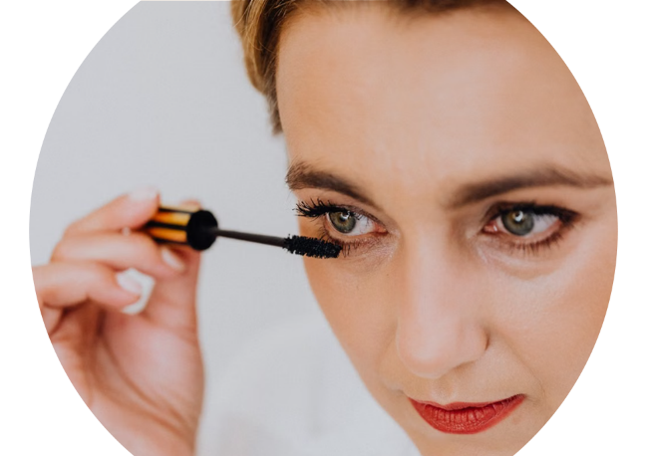
07 / TAKE IT OFF
Waterproof mascara in six steps
NIGHT
EYES 02.
EYES 02
If mascara remains, pause again. Do not pick or pull sideways.
01
Lenses out
Remove contacts first.
EYES
02
Saturate
Use enough eye remover.
03
Hold
Hold on lashes for about 10 seconds.
04
Slide down
Move gently with the lashes.
05
Detail
Use a damp swab at the roots.
06
Check
Check once with a fresh pad.
Glow Beauty | Daily Inspiration Hubdaily | inspirationhub.com

Slide 12
07 / TAKE IT OFF
Never peel lashes off dry
NIGHT
EYES 03.
Loosen the glue first. A strip lash should release without pulling your real lashes.
EYES 03
PRODUCT + HOW
EYES
Dab remover along the band, starting at the outer corner.
Wait for the glue to soften, then lift with fingertips.
Clean reusable strips as directed and let them dry.
Result: the strip lifts cleanly and natural lashes stay put.
Note:
Stop if it hurts or tugs; add a little more remover and wait.
Glow Beauty | Daily Inspiration Hubdaily | inspirationhub.com

Slide 13
07 / TAKE IT OFF
Two-pass lip removal
NIGHT
LIPS.
A stain may need a softening layer before it lifts. Do not scrub dry lips.
LIPS
PRODUCT + HOW
LIPS
Apply balm, cleansing oil, or remover first.
Let it sit, then press and lift with tissue or a pad.
Repeat only where pigment remains in lip lines.
Result: clean color with soft, comfortable lips.
Finish with a thin balm. Skip aggressive scrubs on flaky lips.
Glow Beauty | Daily Inspiration Hubdaily | inspirationhub.com

Slide 14
07 / TAKE IT OFF
Break down the base before washing
NIGHT
BASE MAKEUP
Long-wear base and sunscreen lift more evenly when oil or balm loosens them first.
PRODUCT + HOW
BASE MAKEUP
Start with dry hands, a dry face, and a small amount.
Massage lightly, including hairline and jaw.
Add a little water to emulsify, then rinse well.
Result: no base pigment and no heavy oily film.
Note:
Check around the nose, brows, ears, and jaw. Keep the massage light.
Glow Beauty | Daily Inspiration Hubdaily | inspirationhub.com

Slide 15
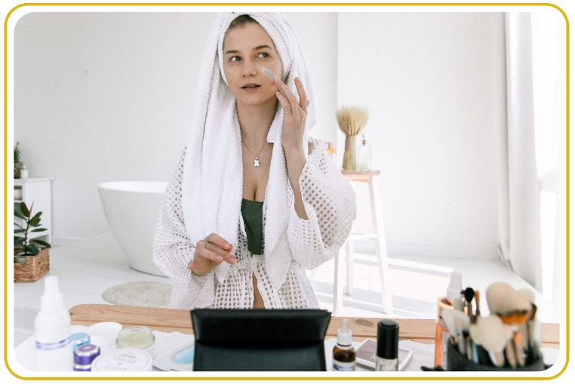
07 / TAKE IT OFF
When a double cleanse helps
NIGHT
DOUBLE CLEANSE
The first step breaks down wear. The second step cleans the skin.
01
Waterproof
Remove by area, then cleanse.
DOUBLE CLEANSE
02
Long-wear base
Use oil or balm first.
03
Layered SPF
Break it down, then wash.
04
Oily film
A second cleanse removes residue.
05
Base remains
Stop wiping and switch to cleanser.
Keep the second cleanse gentle. Do not chase a squeaky-tight finish.
Glow Beauty | Daily Inspiration Hubdaily | inspirationhub.com

Slide 16
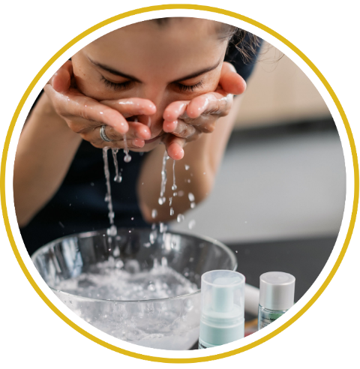
07 / TAKE IT OFF
A gentle cleanse in six steps
NIGHT
CLEANSE
Lukewarm
Skip very hot water.
01
Small amount
Spread it in your hands first.
02
CLEANSE
Pat dry
Pat with a clean soft towel.
06
03
Gentle cleanse
Use fingertips and light circles.
Rinse well
Rinse until no cleanser remains.
05
04
Check edges
Check hairline, nose, and jaw.
Skin should feel fresh and soft, not tight for the rest of the night.
Glow Beauty | Daily Inspiration Hubdaily | inspirationhub.com

Slide 17
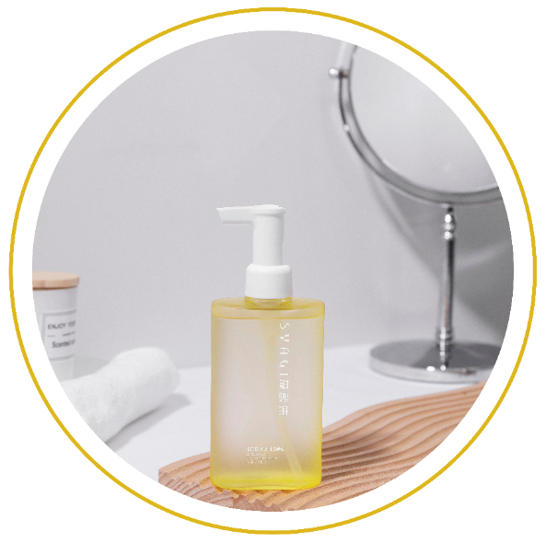
07 / TAKE IT OFF
Seal, don't strip
NIGHT
AFTERCARE
Once the makeup is gone, stop cleansing. Add moisture back while the skin is still slightly damp.
AFTERCARE
Comfort is the finish line.
Glow Beauty | Daily Inspiration Hubdaily | inspirationhub.com

Slide 18
07 / TAKE IT OFF
Moisturize while skin is slightly damp
NIGHT
MOISTURIZE
Use enough to remove tightness, not so much that the face feels coated.
PRODUCT + HOW
MOISTURIZE
Oily or normal: a light lotion may feel best.
Dry: use a richer cream on the areas that need it.
Tap around the orbital bone and keep cream out of the eyes.
Result: soft, calm skin without that over-cleansed feel.
Note:
Patch test new products and stop if burning, redness, or swelling continues.
Glow Beauty | Daily Inspiration Hubdaily | inspirationhub.com

Slide 19
07 / TAKE IT OFF
Five habits that make removal rough
NIGHT
REMOVAL MISTAKES
Most irritation comes from too much rubbing, heat, or repetition.
Scrubbing
Pause first, then slide down.
02
Hot water
Switch to lukewarm water.
01
REMOVAL MISTAKES
Wipes only
Fine in a pinch; cleanse full wear.
04
Dirty cloth
Wash and dry after every use.
03
05
No moisturizer
Add a layer while slightly damp.
Note:
If skin gets hot, stingy, or redder, stop, rinse, and simplify.
Glow Beauty | Daily Inspiration Hubdaily | inspirationhub.com

Slide 20
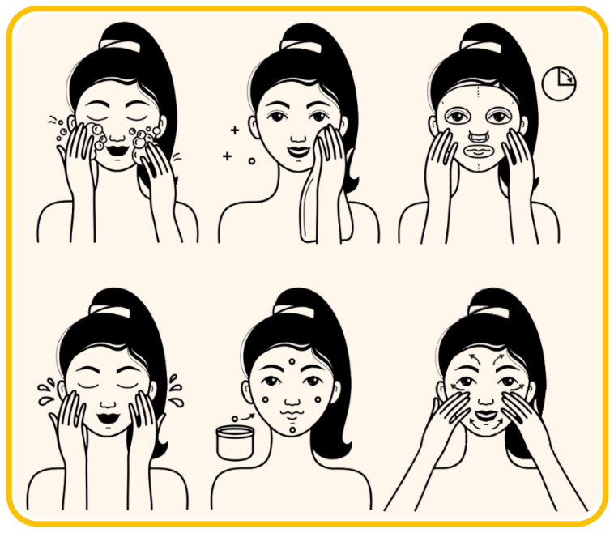
07 / TAKE IT OFF
The tired-night minimum
NIGHT
TAKE IT OFF
You do not need ten steps tonight. Remove, cleanse, moisturize, done.
01
Prep
Wash hands and tie hair back.
THE TIRED-NIGHT MINIMUM
02
Eyes + lips
Pause, then wipe gently.
03
Melt base
Use one oil or balm step.
04
Cleanse
Rinse well; do not repeat.
05
Moisturize
One simple layer, then bed.
Glow Beauty | Daily Inspiration Hubdaily | inspirationhub.com

Slide 21
07 / TAKE IT OFF
What clean skin should feel like
NIGHT
FINISH CHECK
Clean skin is free of visible makeup, but it should not feel rubbed raw or painfully tight.
LOOK FOR THIS
FINISH CHECK
No base pigment at hairline, nose, or jaw.
Lash line and lip lines look clean.
Skin does not keep burning, stinging, or pulling tight.
Final effect: clean, soft, calm, and ready for bed.
Note:
Stop the product and seek appropriate care for persistent swelling, pain, or vision changes.
Glow Beauty | Daily Inspiration Hubdaily | inspirationhub.com

Slide 22
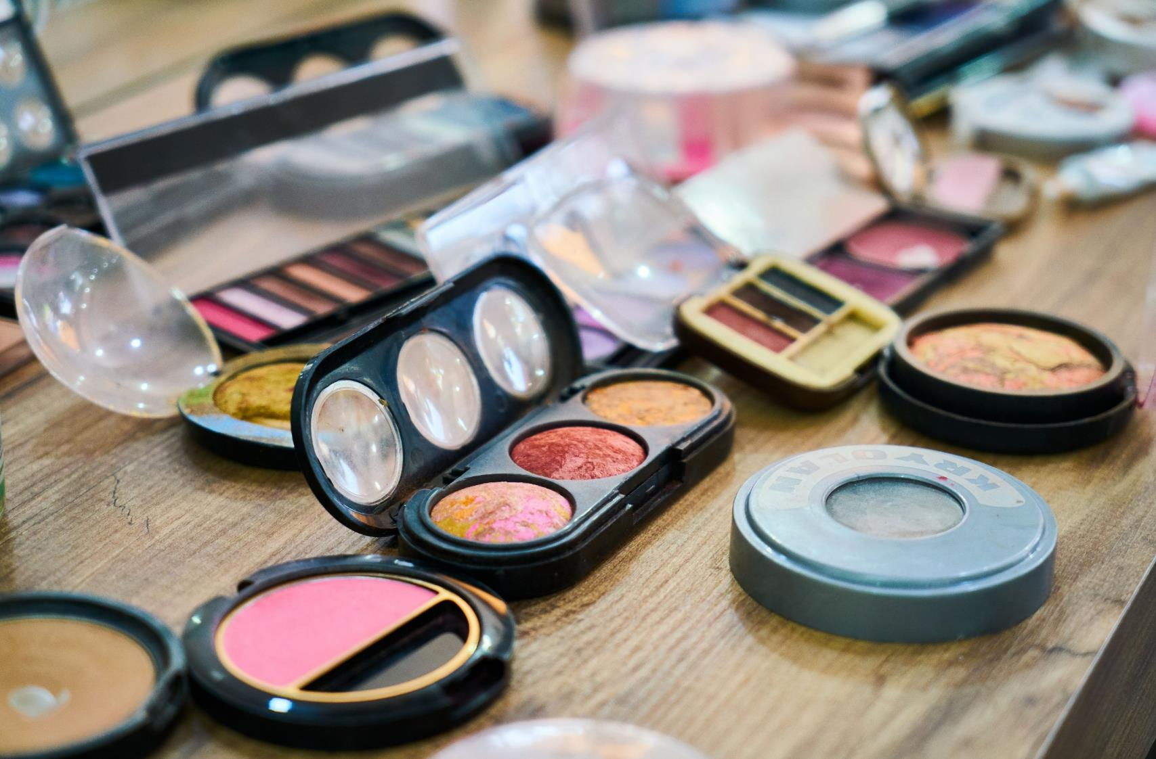
07 / TAKE IT OFF
Remover brand ideas, not must-buys
NIGHT
Choose by makeup type, comfort, and how easy the formula is to control.
01 Micellar: Bioderma · Garnier
06 Cleanser: CeraVe · Vanicream
02 Balm: Clinique · Farmacy
07 Waterproof: Clinique · Lancôme
REMOVER BRANDS
03 Oil: Bobbi Brown · MAC
08 Travel: Garnier · Simple
04 Eye/lip: Lancôme · NIVEA
09 Fragrance-free: CeraVe · Vanicream
05 Sensitive: Avène · Vanicream
10 Gentle: Bioderma · Simple
The right pick works fast, feels comfortable, and fits your routine.
Glow Beauty | Daily Inspiration Hubdaily | inspirationhub.com

Slide 23
07 / TAKE IT OFF
Keep aftercare simple
NIGHT
AFTERCARE BRANDS.
One comfortable moisturizer is more useful than a crowded shelf.
01 Lotion: CeraVe · Clinique
06 Oily: CeraVe · Neutrogena
AFTERCARE BRANDS
02 Cream: Kiehl's · Eucerin
07 Dry: Eucerin · CeraVe
03 Lip balm: Aquaphor · Vaseline
08 Barrier: Avène · La Roche-Posay
04 Eye cream: Clinique · Kiehl's
09 Cloth: MakeUp Eraser · Garnier
05 Sensitive: Avène · Vanicream
10 SPF: EltaMD · Supergoop!
Start with one cleanser and one moisturizer; add more only after the basics feel steady.
Glow Beauty | Daily Inspiration Hubdaily | inspirationhub.com

Slide 24
07 / TAKE IT OFF
Pick tonight's removal route
NIGHT
QUICK DECISION
Every route keeps eye and lip removal gentle. No back-and-forth rubbing.
QUICK DECISION
01
02
03
04
LIGHT
Micellar water, gentle cleanse, moisturize.
WATERPROOF
Eye remover first, then cleanse the face.
FULL BASE
Oil or balm, gentle second cleanse, moisturize.
TIRED
Remove, cleanse, moisturize, bed.
Glow Beauty | Daily Inspiration Hubdaily | inspirationhub.com

Slide 25
07 / TAKE IT OFF
One simple routine, seven chapters
NIGHT
THE WHOLE GUIDE.
01
Know products
Know what each product does.
02
Prep skin
Cleanse, moisturize, protect.
THE WHOLE GUIDE
03
Build the base
Use thin layers and spot fixes.
04
Shape + color
Frame, define, and add color.
05
Check balance
Step back and stop when it works.
06
Remove + reset
Dissolve, cleanse, seal, sleep.
It does not need to be perfect. A good routine is comfortable and repeatable.
Glow Beauty | Daily Inspiration Hubdaily | inspirationhub.com

Slide 26
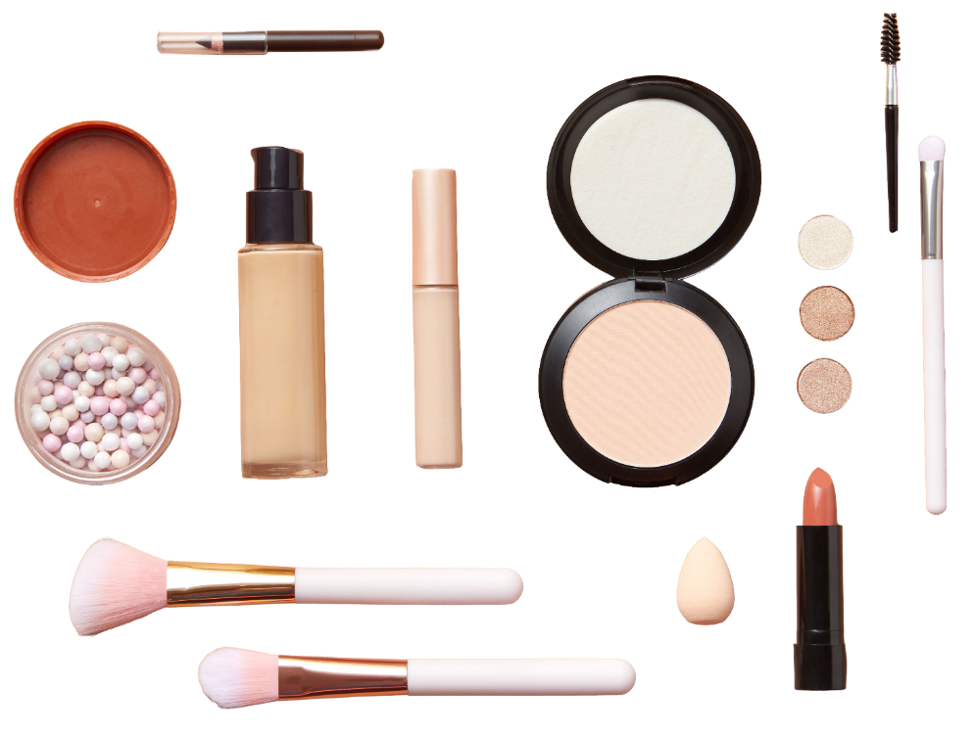
YOU'RE READY.
Keep the routine simple, then make it yours. Save this guide, practice at your own pace, and come back whenever you need a reset.
DAILY INSPIRATION HUB
dailyinspirationhub.com
Pinterest: @dailyinspirationhubs
Glow Beauty | Daily Inspiration Hubdaily | inspirationhub.com
Notes:
[Sources]
- C:/Users/Administrator/AppData/Local/Temp/codex-clipboard-a0eb4709-d0e1-4bef-9578-3ce2fd641c5b.png

