Slide 1
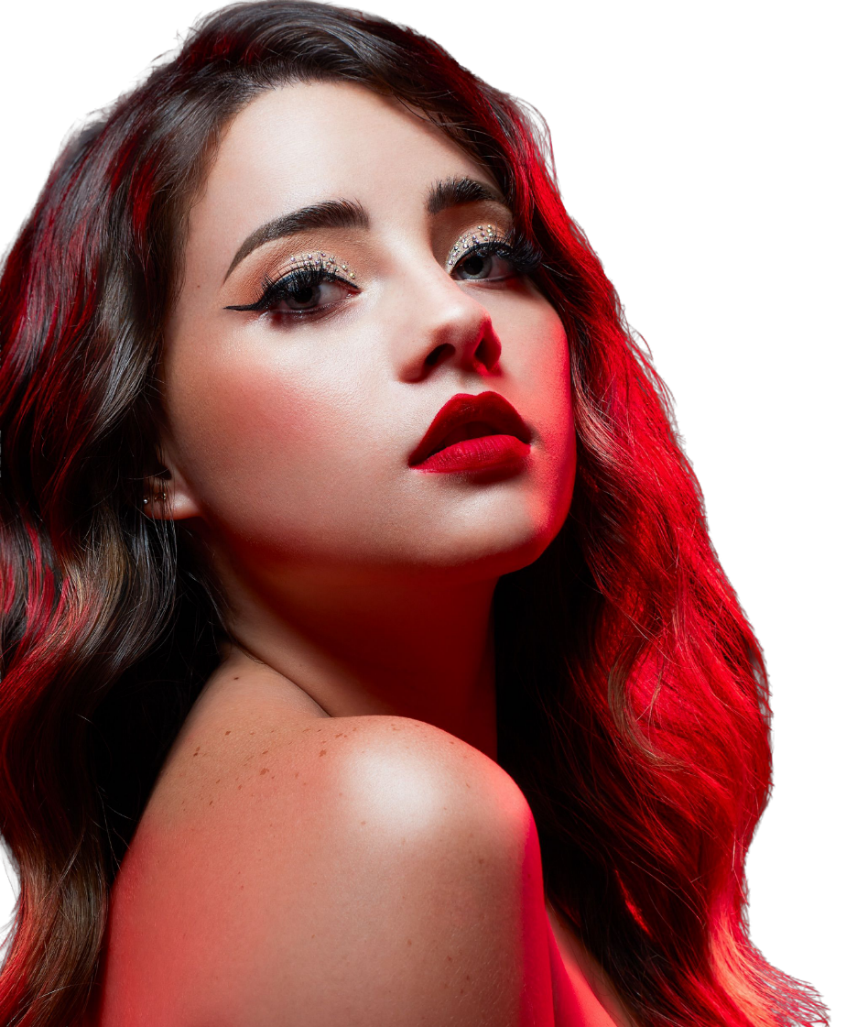
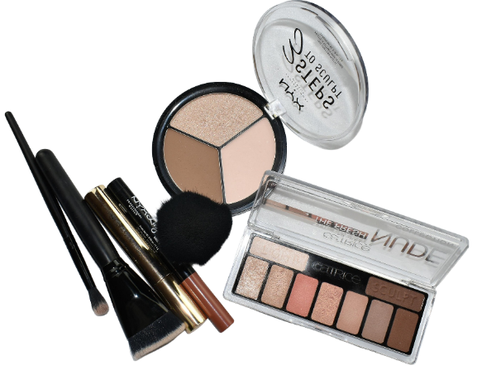
Everyday
Makeup Playbook
Classic | Fashion | Trends
DAILY INSPIRATION HUB / dailyinspirationhub.com / @dailyinspirationhubs
Everyday makeup that looks like you
(Part-02)
Glow Beauty | Daily Inspiration Hubdaily | inspirationhub.com

Slide 2
CONTENTS
What's Inside
01
The Purpose of Makeup
05
Skin prep
Why we wear makeup & what it does
Morning & night routines for healthy skin
02
Skin + Look
06
Makeup Application Steps
Styles, skin classifications & care
Brows, eyes, shadow & liner techniques
03
Build my KIT
07
Makeup Looks and Skin Types
The importance of bottom makeup
Take off formal dress and ornaments
04
Build the base
An introduction to a dresser
Glow Beauty | Daily Inspiration Hubdaily | inspirationhub.com

Slide 3
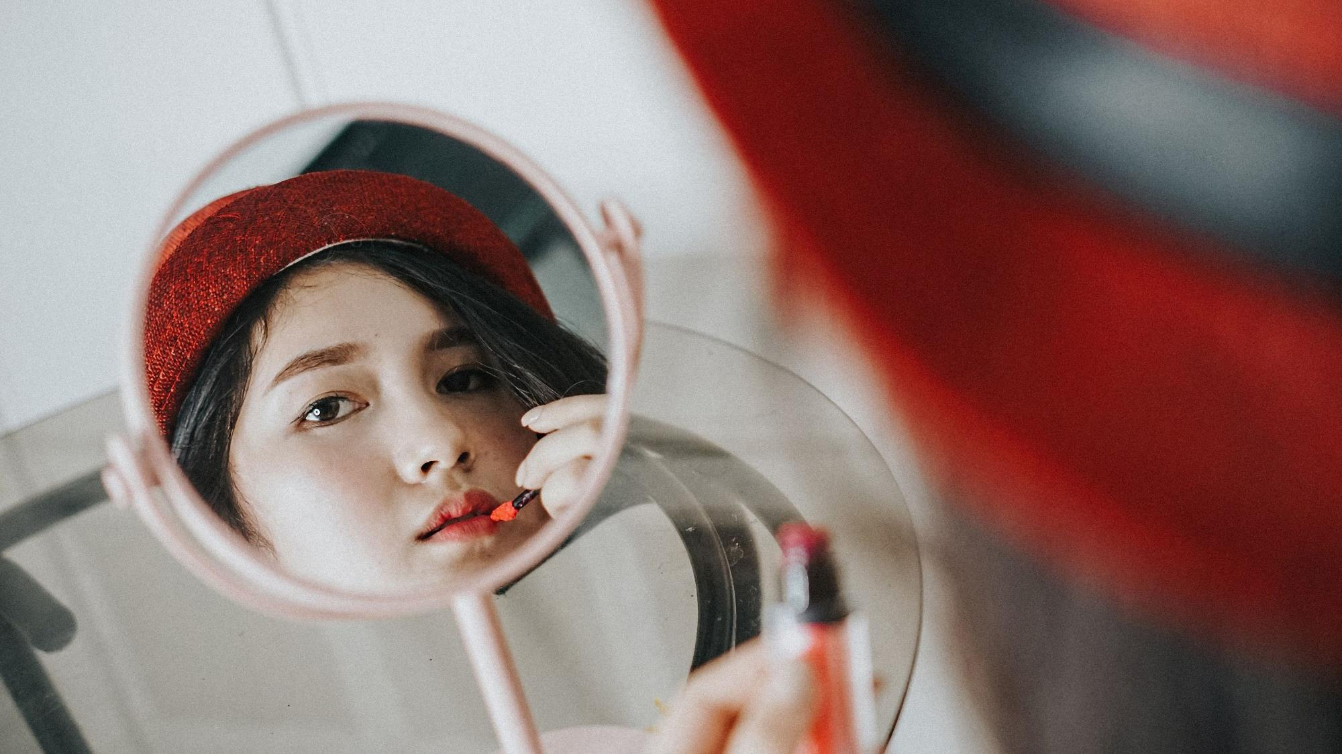
Makeup is a tool, not a mask.
PART SIX
Apply with intention
Tap, feather, and build. Pressure matters more than piling on product.
Six moves, one finished face
Glow Beauty | Daily Inspiration Hubdaily | inspirationhub.com

Slide 4
06 / APPLY WITH INTENTION
Six moves, one finished face
The order is flexible. Check the whole face before adding more.
Work on one feature at a time, then step back and connect the whole look.
CHAPTER ROADMAP
CHAPTER ROADMAP
01
Frame brows
Brush, map, and fill gaps.
04
Bring in blush
Start small and blend upward.
01
Frame brows
02
Add eye depth
02
Add eye depth
Light first, depth second.
05
Finish lips
Prep, shape, then color.
03
Line + lashes
04
Bring in blush
Line + lashes
Define roots; keep tips clean.
Balance
Step back, soften, and stop.
05
Finish lips
03
06
06
Balance
Glow Beauty | Daily Inspiration Hubdaily | inspirationhub.com

Slide 5
06 / APPLY WITH INTENTION
Ten tools can do the whole look
Clean tools, clean hands. Buy less and practice more.
Keep the kit small enough that you know what every tool is for.
01 Spoolie
06 Eyeliner + cotton swabs
THE BEGINNER TOOLKIT
02 Brow pencil + gel
07 Curler + mascara
03 Four-tone neutral shadow
08 Blush + brush or sponge
04 Fluffy eye brush
09 Balm + lip color
05 Small detail brush
10 Tissue + remover
Glow Beauty | Daily Inspiration Hubdaily | inspirationhub.com

Slide 6
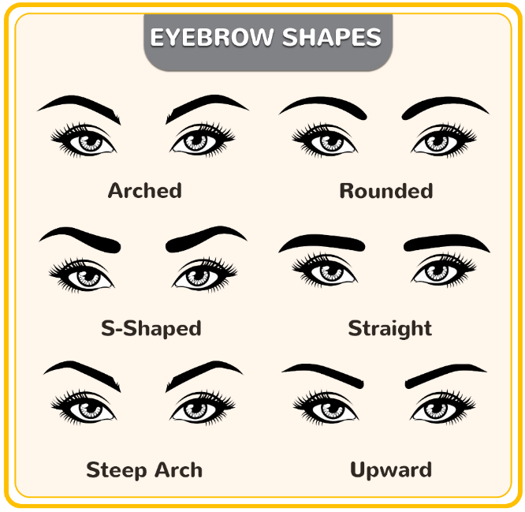
06 / APPLY WITH INTENTION
The three-point brow map
BROWS: FRAME, DON'T REDRAW.
Brows should look like sisters, not identical twins.
1 START
Fill the gaps.
BROW KIT
BROWS
Pencil for precision
Gel for hold
Spoolie to soften
Dark hair: try one shade lighter
2 ARCH
Soft front. Lift the arch.
3 TAIL
Fine tail. No hook.
Glow Beauty | Daily Inspiration Hubdaily | inspirationhub.com

Slide 7
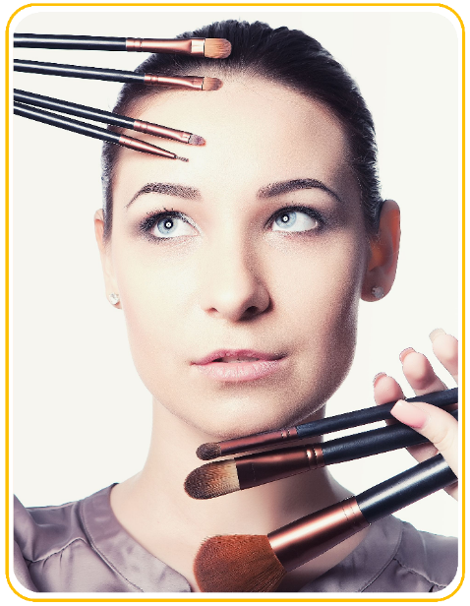
06 / APPLY WITH INTENTION
Pick product and shade
BROWS: FRAME, DON'T REDRAW.
The easiest brow still looks like brow hair.
Choose control over heavy pigment.
PRODUCT + HOW
Pencil fills gaps and draws fine strokes.
BROWS
Gel brushes, holds, and adds light color.
Match the roots; go slightly lighter for dark hair.
Result: visible hairs and skin, never a solid stamp.
Taupe and ash brown often look natural. Use warm brown for warm hair, and test pressure on your hand first.
Glow Beauty | Daily Inspiration Hubdaily | inspirationhub.com

Slide 8
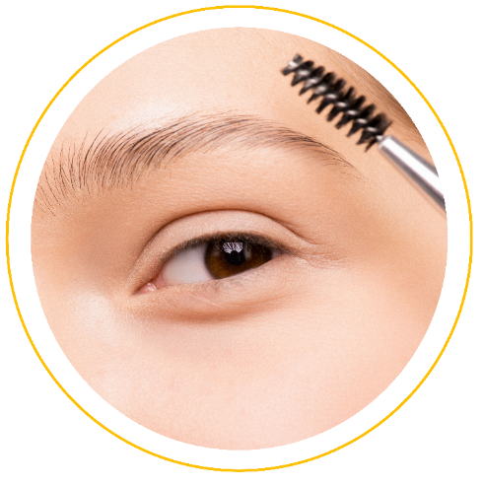
06 / APPLY WITH INTENTION
Natural brows in six steps
Check both brows as you go. Aim for balance, not identical copies.
Use the lightest pressure at the front and build only through the middle and tail.
Brush
Brush hairs up and outward.
01
Map
Mark start, arch, and tail lightly.
02
BROW FIXES
Set
Add one light coat of brow gel.
06
03
Lower edge
Sketch a thin line from middle to tail.
Soften
Use a spoolie to blur hard edges.
05
04
Fill gaps
Use short, hair-like strokes.
Glow Beauty | Daily Inspiration Hubdaily | inspirationhub.com

Slide 9
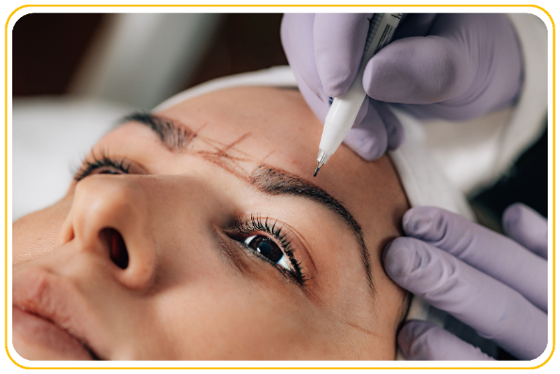
06 / APPLY WITH INTENTION
5 drawn-on brow mistakes
Five things that make brows look drawn on.
Most brow problems come from pressure, not from the product itself.
01
Blocky front
Leave space and brush color forward.
BROW FIXES
02
Too dark
Go lighter and ease up on pressure.
03
Tail too long
Stop near the outer corner and taper.
04
Heavy top line
Define below; let hairs shape the top.
Quick fix:
spoolie first, then lift heavy edges with a cotton swab.
05
Symmetry trap
Step back; do not keep making both thicker.
Glow Beauty | Daily Inspiration Hubdaily | inspirationhub.com

Slide 10

06 / APPLY WITH INTENTION
What finished brows look like
A good brow frames the eye without becoming the first thing you notice.
Check from an arm's length away; compare the fronts and tail lengths.
LOOK FOR THIS
Front: soft, airy, and hair-like.
Arch: lifted, never sharply bent.
Tail: clean, tapered, and not hooked.
BROW FINISH
Final effect: balanced from far away and believable up close.
Glow Beauty | Daily Inspiration Hubdaily | inspirationhub.com

Slide 11
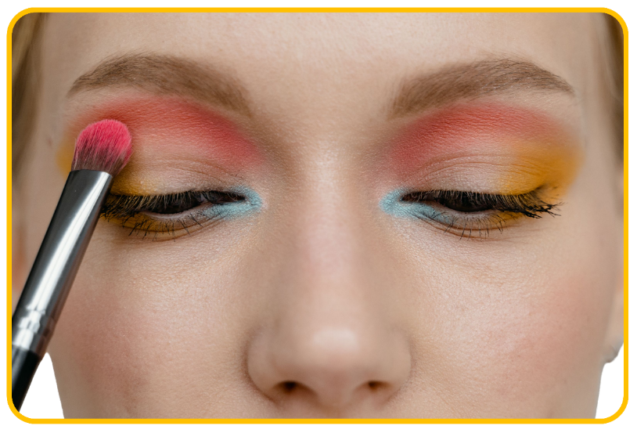
06 / APPLY WITH INTENTION
Light first, depth second
Blend more than you add.
Keep the lid open and the edges soft. Depth belongs close to the crease and lashes.
EYES
Glow Beauty | Daily Inspiration Hubdaily | inspirationhub.com

Slide 12
06 / APPLY WITH INTENTION
A four-shade eye map
EYES: LIGHT FIRST, DEPTH SECOND
Keep the lid light, add a mid-tone through the crease, then place deep color close to the lashes.
EYES
LIGHT
all over the lid
MID
crease + outer corner
DEEP
close to the lash line
POP
inner corner or brow bone
Choose a light-to-deep range that shows clearly on your skin. Richer skin tones can use deeper mids and gold, copper, or pearl highlights.
Use a fluffy brush to blend and your ring finger to press shimmer with less fallout.
Glow Beauty | Daily Inspiration Hubdaily | inspirationhub.com

Slide 13
06 / APPLY WITH INTENTION
Prep the lid first
EYES: LIGHT FIRST, DEPTH SECOND
Shadow blends better on a smooth lid that is not wet or greasy.
PRODUCT + HOW
Gently blot oil from the lid first.
EYES
Eye primer is optional; one thin layer is enough.
Oily lids can take a tiny amount of translucent powder.
Result: a smooth lid where the brush moves easily.
Note:
Skip eye makeup during irritation or infection. Put contact lenses in before makeup.
Glow Beauty | Daily Inspiration Hubdaily | inspirationhub.com

Slide 14
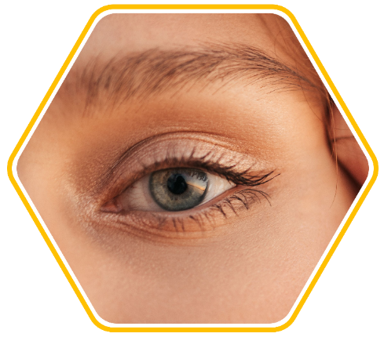
06 / APPLY WITH INTENTION
Soft shadow in six steps
Pick up less than you think. It is easier to add color than to erase a muddy patch.
You should still see light, mid, and deep zones, not one muddy color.
Light base
Sweep from lashes to crease.
01
02
Mid in crease
Keep a little visible with eyes open.
EYES
Clean blend
Use a clean brush over every edge.
06
03
Deepen outer corner
Build in a small outer V.
Add pop
Tap a little at inner corner or brow bone.
05
04
Define lashes
Press deep color close to lashes.
Glow Beauty | Daily Inspiration Hubdaily | inspirationhub.com

Slide 15
06 / APPLY WITH INTENTION
Keep liner close to lashes
EYES: LIGHT FIRST, DEPTH SECOND
Beginner liner is not one perfect swipe. It is a row of tiny strokes that connect.
PRODUCT + HOW
EYES
Pencil is easiest to control; liquid is sharper.
Use short strokes from the middle out, then fill the inner part.
Let the wing follow the lower lash angle.
Result: darker lash roots, not a thick black stripe.
Use a barely damp cotton swab to clean edges. Skip the waterline if sensitive, and never share eye makeup.
Glow Beauty | Daily Inspiration Hubdaily | inspirationhub.com

Slide 16
06 / APPLY WITH INTENTION
Lift lashes from the roots
EYES: LIGHT FIRST, DEPTH SECOND
The goal is lift and separation, not the biggest possible layer of mascara.
PRODUCT + HOW
EYES
Curl first, then apply mascara.
Wipe excess, wiggle at roots, then pull upward.
Add one pass on outer lashes; lower lashes are optional.
Result: defined roots with clean, separated tips.
Note:
Do not pump or share the wand. Replace dry or odd-smelling mascara, usually around three months.
Glow Beauty | Daily Inspiration Hubdaily | inspirationhub.com

Slide 17
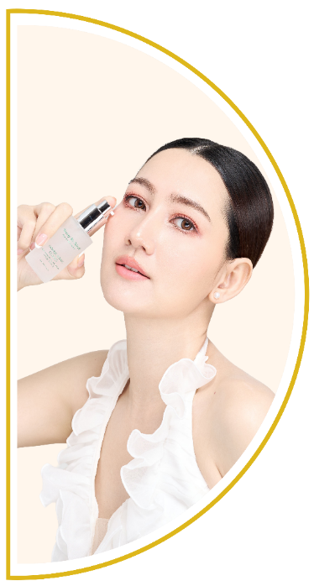
06 / APPLY WITH INTENTION
Five quick eye-makeup fixes
Fix the one thing you notice first, then stop and look again.
Most eye looks improve when you remove excess and soften one edge.
01
Fallout
Brush away, then touch up concealer.
EYE FIXES
02
Muddy color
Stop adding and use a clean brush.
03
Too much depth
Press light color back onto the lid.
04
Uneven liner
Thin the heavy side; do not keep adding.
05
Clumpy lashes
Separate with a clean comb before dry.
Glow Beauty | Daily Inspiration Hubdaily | inspirationhub.com

Slide 18
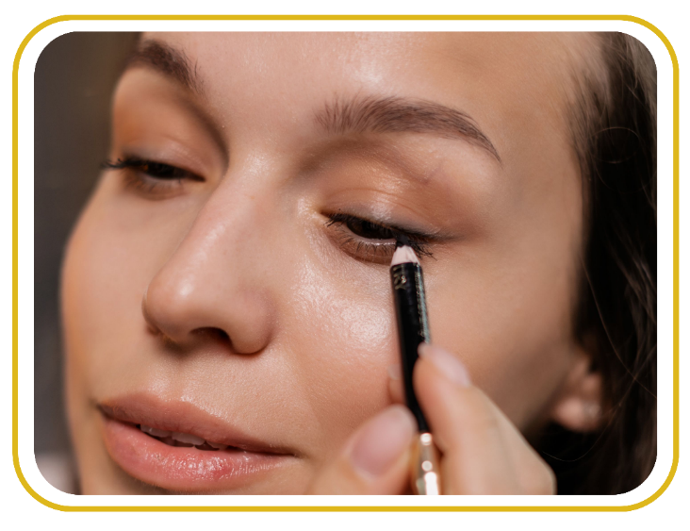
06 / APPLY WITH INTENTION
What finished eyes look like
EYE FINISH
A finished eye has clear depth, soft edges, and enough open lid space to stay fresh.
LOOK FOR THIS
Light color is still visible on the lid.
Deepest color stays near outer corner and lashes.
Edges fade out with no obvious blocks.
EYE FINISH
Final effect: more definition, while the eye still comes before the makeup.
Glow Beauty | Daily Inspiration Hubdaily | inspirationhub.com

Slide 19

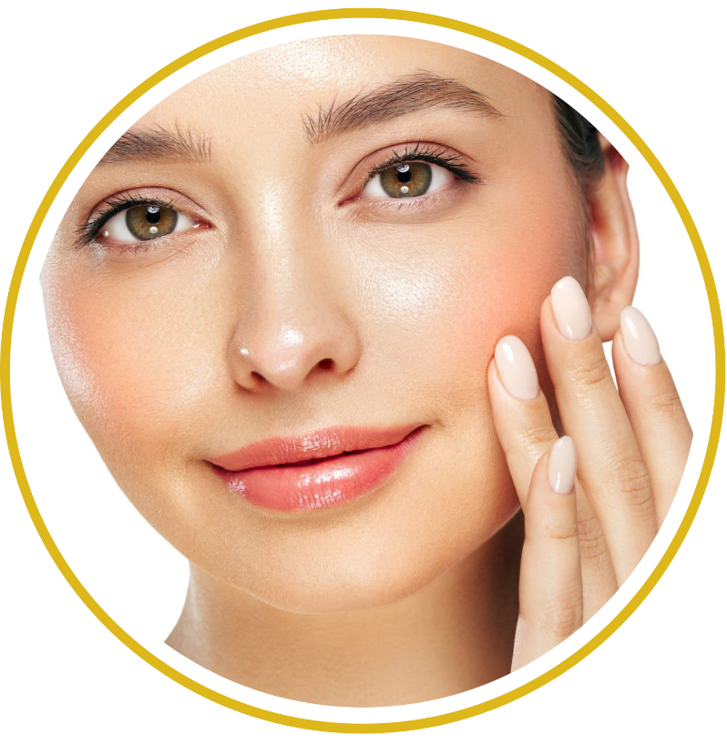
06 / APPLY WITH INTENTION
Keep the color story together
A little color beats a hard stripe.
CHEEKS + LIPS
Repeat one color family across cheeks, eyes, and lips, then let one feature lead.
Glow Beauty | Daily Inspiration Hubdaily | inspirationhub.com

Slide 20
06 / APPLY WITH INTENTION
Four placements, four moods
BLUSH PLACEMENT.
Four placements, four moods
01
FRESH
Tap the apples, then blend softly upward.
CHEEKS
02
LIFTED
Place high on cheeks and blend to temples.
03
SUN-KISSED
Sweep lightly across cheeks and a touch on nose.
04
SCULPTED
Keep color on the outer cheekbone, not in a hard stripe.
Pick one direction. Smile to locate, then relax your face and check again.
Glow Beauty | Daily Inspiration Hubdaily | inspirationhub.com

Slide 21
06 / APPLY WITH INTENTION
Cream or powder?
BLUSH PLACEMENT.
Both work. Choose the texture that fits your base and the tools you like using.
CHEEKS
PRODUCT + HOW
CHEEKS
Cream: tap on with fingers or sponge before powder.
Powder: sweep on lightly with a fluffy brush after setting.
Layer only for extra wear; one formula is usually enough.
Result: color that looks like it comes through the skin.
Tap excess from the brush. Test liquid blush on your hand, and press with a base sponge if color gets too strong.
Glow Beauty | Daily Inspiration Hubdaily | inspirationhub.com

Slide 22
06 / APPLY WITH INTENTION
Prep before color
BLUSH PLACEMENT.
Lip color sits better on a smooth surface, but too much balm makes it slide.
LIPS
PRODUCT + HOW
LIPS
Apply balm and let it sit for about five minutes.
Blot away extra slip before adding color.
For flakes, use a damp soft cloth; do not scrub hard.
Result: smooth, comfortable lips without a greasy surface.
Lip liner is optional. Use it only where you want shape, not as a heavy ring around the mouth.
Glow Beauty | Daily Inspiration Hubdaily | inspirationhub.com

Slide 23
06 / APPLY WITH INTENTION
Prep before color
BLUSH PLACEMENT.
Lip color sits better on a smooth surface, but too much balm makes it slide.
LIPS
PRODUCT + HOW
LIPS
Apply balm and let it sit for about five minutes.
Blot away extra slip before adding color.
For flakes, use a damp soft cloth; do not scrub hard.
Result: smooth, comfortable lips without a greasy surface.
Lip liner is optional. Use it only where you want shape, not as a heavy ring around the mouth.
Glow Beauty | Daily Inspiration Hubdaily | inspirationhub.com

Slide 24
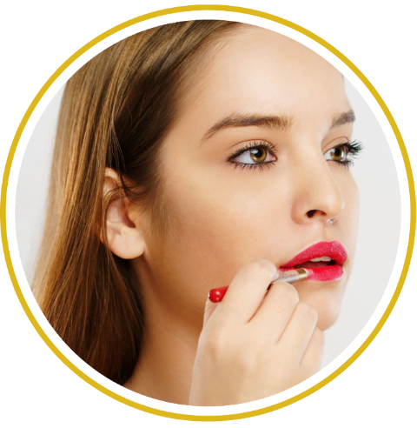
06 / APPLY WITH INTENTION
Natural lip color in six steps
If color looks uneven, blot first and rebuild with one thin layer.
Build from the center and keep the edge as sharp or as soft as the look needs.
Prep
Balm for five minutes, then blot.
01
Shape
Line only uneven or faded edges.
02
LIPS
Blur or clean
Blur for a stain or clean for precision.
06
03
Fill center
Start at the center of both lips.
Blot + layer
Blot once, then add a thin second layer.
05
04
Blend out
Blend outward with a brush or finger.
Glow Beauty | Daily Inspiration Hubdaily | inspirationhub.com

Slide 25
06 / APPLY WITH INTENTION
Keep the color story together
Colors do not need to match exactly; let the temperature and depth echo.
Make your blush, eyeshadow, and lip color speak the same language — so the whole look feels intentional instead of thrown together.
COLOR HARMONY
01
ROSE
Translucent, soft, cool-toned
Try rose blush, mauve shadow, and a muted pink lip.
02
PEACH
Warm, lively, glowing
Pair peach cheeks with warm brown eyes and coral lips.
03
BERRY
Rich, mature, high-contrast
Use berry on one feature and echo it softly elsewhere.
04
NUDE
Calm, everyday, natural glow
Choose a nude with enough contrast so the face does not look flat.
Glow Beauty | Daily Inspiration Hubdaily | inspirationhub.com

Slide 26
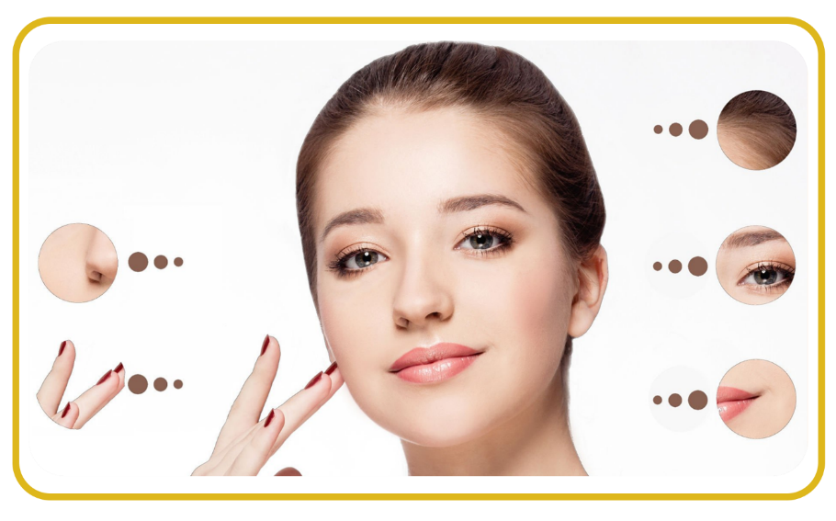
06 / APPLY WITH INTENTION
The last check ties it together
Do not add more everywhere. Find the one edge, gap, or imbalance that actually needs help.
ake two steps back, relax your face, and check in natural light. If it works, stop.
01 Brows
Fronts soft; tails not too long.
FINAL 10%
02 Eyes
Depth matches and edges look clean.
05 Balance
One feature leads; the others support it.
04 Lips
Edges look intentionally sharp or blurred.
03 Cheeks
Color lifts with no hard stripe.
Glow Beauty | Daily Inspiration Hubdaily | inspirationhub.com

Slide 27

06 / APPLY WITH INTENTION
Too much? Reset, don't restart
Set only where needed, then finish.
Use clean tools and small corrections. Most heavy makeup needs softening, not another layer.
01
Step back
Find the one issue pulling attention.
THE
FIVE-MINUTE RESET
02
Clean fallout
Brush away, then touch up the base.
03
Soften edges
Use a clean brush, spoolie, or sponge.
04
Balance color
Blot the heavy side; add only a touch elsewhere.
05
Set + stop
Set only where needed, then finish.
Glow Beauty | Daily Inspiration Hubdaily | inspirationhub.com

Slide 28
06 / APPLY WITH INTENTION
Brand ideas, not must-buys
Choose the formula you can control and will actually use.
The beginner pick is the one with buildable color and easy control.
01 Brow pencil: Benefit · NYX
06 Mascara: MAC · Clinique
PRODUCT EXAMPLES
02 Brow gel: Glossier · e.l.f.
07 Blush: NARS · Rare Beauty
03 Shadow: Urban Decay · e.l.f.
08 Lip liner: MAC · NYX
04 Eye primer: NARS · Milani
09 Lip color: Dior · MAC
05 Liner: Stila · NYX
10 Brushes: Real Techniques · Sigma
YOU'RE READY.
Frame with brows, add depth to the eyes, bring in color, then step back.
Glow Beauty | Daily Inspiration Hubdaily | inspirationhub.com

Slide 29
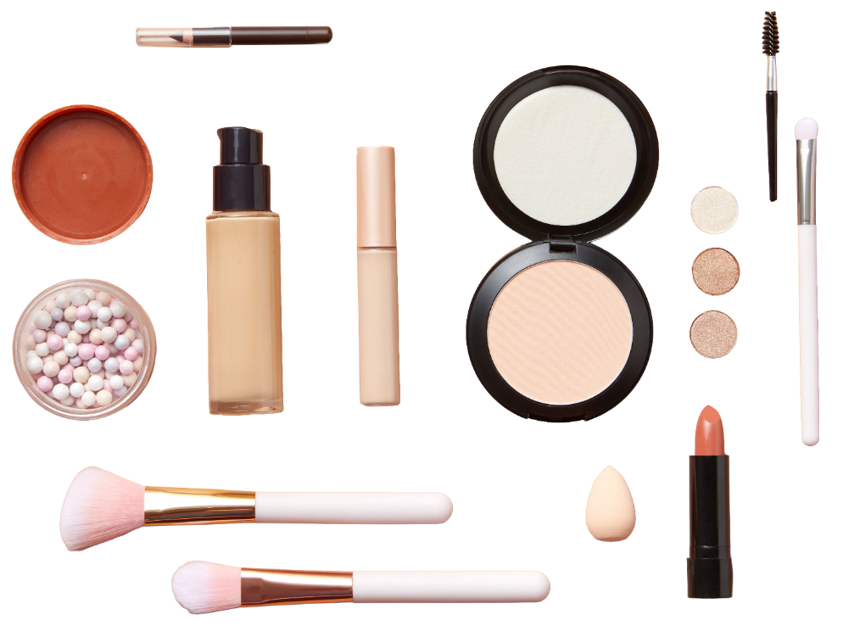
YOU'RE READY.
Keep the routine simple, then make it yours. Save this guide, practice at your own pace, and come back whenever you need a reset.
DAILY INSPIRATION HUB
dailyinspirationhub.com
Pinterest: @dailyinspirationhubs
Glow Beauty | Daily Inspiration Hubdaily | inspirationhub.com
Notes:
[Sources]
- C:/Users/Administrator/AppData/Local/Temp/codex-clipboard-a0eb4709-d0e1-4bef-9578-3ce2fd641c5b.png

