Slide 1
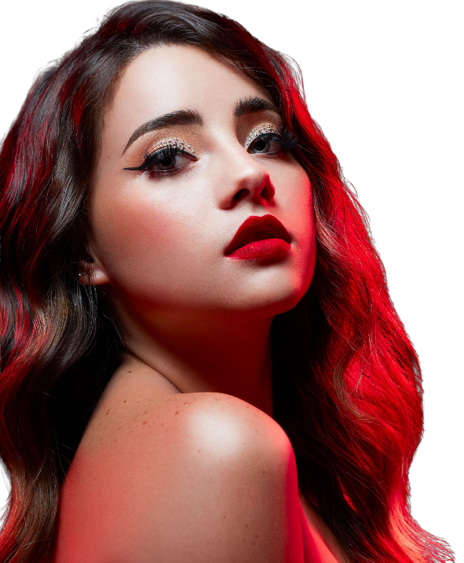
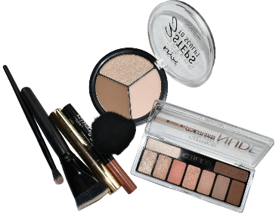
Everyday
Makeup Playbook
Classic | Fashion | Trends
DAILY INSPIRATION HUB / dailyinspirationhub.com / @dailyinspirationhubs
Everyday makeup that looks like you
(Part-01)
Glow Beauty | Daily Inspiration Hubdaily | inspirationhub.com

Slide 2
CONTENTS
What's Inside
01
The Purpose of Makeup
05
Skin prep
Why we wear makeup & what it does
Morning & night routines for healthy skin
02
Skin + Look
06
Makeup Application Steps
Styles, skin classifications & care
Brows, eyes, shadow & liner techniques
03
Build my KIT
07
Makeup Looks and Skin Types
The importance of bottom makeup
Take off formal dress and ornaments
04
Build the base
An introduction to a dresser
Glow Beauty | Daily Inspiration Hubdaily | inspirationhub.com

Slide 3
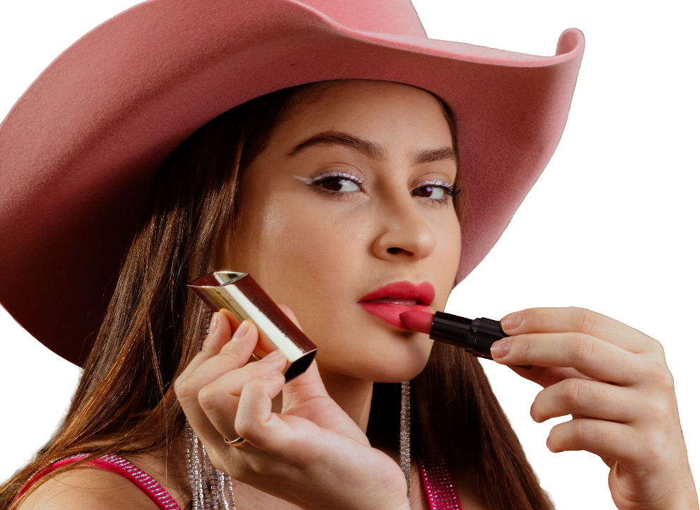
PART ONE
The Purpose of Makeup
Why makeup
Enhance what is already there. Correct what distracts you. Show up feeling like yourself.
Glow Beauty | Daily Inspiration Hubdaily | inspirationhub.com

Slide 4

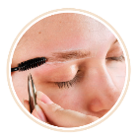
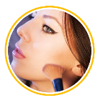

01 / WHY MAKEUP
The Purpose of Makeup
Why makeup
01 Enhance the Skin
03 Basic Courtesy
Use color to modify your face shape and flaws (dark circles, acne, scars) to show your individual beauty and unique charm.
Appropriate makeup shows respect and attention to others, highlights your politeness and self-cultivation, and makes your eyes and smile more kind.
02 Protective Benefits
04 Social Confidence
Form an extra layer of protective film outside the skin. Proper makeup prevents bacteria, dust, UV rays, and daily radiation from directly reaching…
Makeup can bring out inner confidence and outward polish at any age.
Glow Beauty | Daily Inspiration Hubdaily | inspirationhub.com

Slide 5
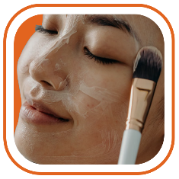
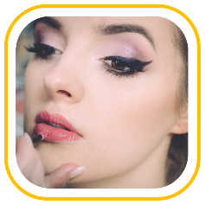
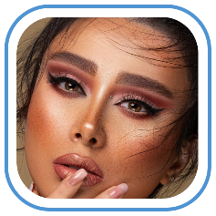
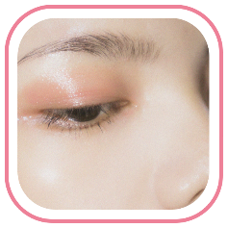
01 / WHY MAKEUP
The Purpose of Makeup
Why makeup
Cover, Protect
Highlight Your
Best Features
Feel More
Confident
Create a Polished,
Comfortable
Impression
The best routine does three jobs at once: it protects your skin, makes your features pop, and lets you get on with your day.
Glow Beauty | Daily Inspiration Hubdaily | inspirationhub.com

Slide 6

PICK A FINISH, NOT A RULE
PART TWO
SKIN + LOOK
SKIN + LOOK
Your finish starts before foundation. Read your skin, then choose the vibe.
Glow Beauty | Daily Inspiration Hubdaily | inspirationhub.com

Slide 7

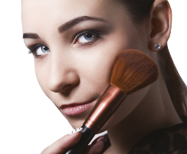
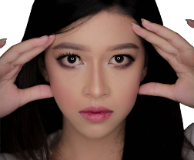
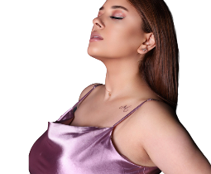
02 / SKIN + LOOK
Four makeup lanes
There is no one-size-fits-all face. Let the occasion, your skin, and your mood call the shots.
EVERYDAY
POLISHED
STATEMENT
EDITORIAL
Soft, breathable, quick
Clean and camera-ready
Color does the talking
Play with shape+texture
Tinted base, brushed brows,
cream blush, tinted lip.
Medium base, defined eyes,
shaped brows, satin lip.
Graphic liner, strong blush,
bold lip, or all three.
Gloss, shimmer, sculpting, unexpected color.
Have fun.
Shortcut:
If your base looks heavy, your prep is probably too light — or your layers are too thick.
Glow Beauty | Daily Inspiration Hubdaily | inspirationhub.com

Slide 8
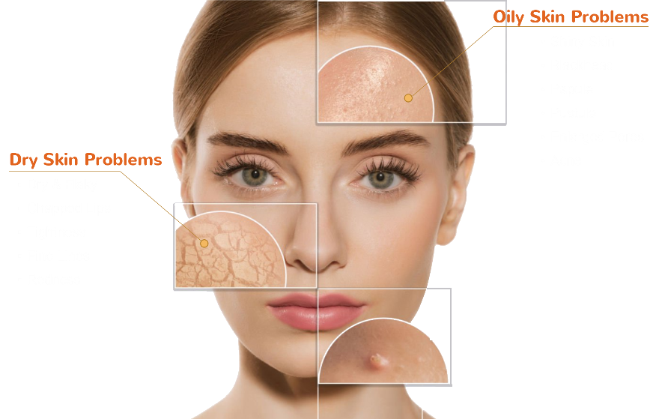
02 / SKIN + LOOK
Skin Types
COMMON SKIN PROBLEMS BY SKIN TYPE
Glow Beauty | Daily Inspiration Hubdaily | inspirationhub.com

Slide 9
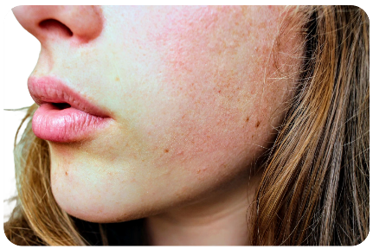
02 / SKIN + LOOK
Skin Types
Common Skin Types : Dry, oily, combination, normal, and sensitive skin
01 DRY SKIN
When skin feels tight, makeup shows it first
KEEP IT COMFY
Moisture first, glow second.
Use a creamy cleanser and a proper moisturizer.
Skip aggressive scrubs; they can make flakes worse.
Choose a hydrating, flexible base and tap—don’t drag.
Moisture first, glow second.
skin type can shift with climate, hormones, and stress.
Re-check the basics every few months.
Usually feels tight after cleansing. Flakes, fine lines, and dull patches may show around the eyes, nose, or lips.
Glow Beauty | Daily Inspiration Hubdaily | inspirationhub.com

Slide 10
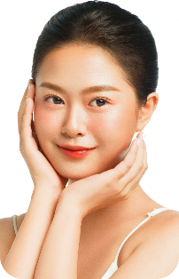
02 / SKIN + LOOK
Skin Types
Common Skin Types : Dry, oily, combination, normal, and sensitive skin
02 NORMAL SKIN
The balanced baseline
DO NOT OVER-CORRECT
Boring is good when your skin feels good.
Stick to a simple daily routine and SPF.
Use lightweight layers so your natural texture still shows.
Watch the seasons—normal skin can still get dehydrated.
skin type can shift with climate, hormones, and stress. Re-check the basics every few months.
Texture is fairly even, pores are less noticeable, and your skin usually does not swing too oily or too dry.
Glow Beauty | Daily Inspiration Hubdaily | inspirationhub.com

Slide 11
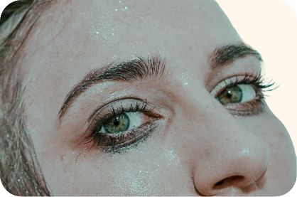
02 / SKIN + LOOK
Skin Types
Common Skin Types : Dry, oily, combination, normal, and sensitive skin
03 OILY SKIN
Shine is not the enemy
CONTROL, DON'T STRIP
Let the glow stay—just put it where you want it.
Cleanse thoroughly but avoid the squeaky-clean feeling.
Use a thin, oil-friendly moisturizer and targeted powder.
Press powder where you need it; leave the rest fresh.
skin type can shift with climate, hormones, and stress. Re-check the basics every few months.
More sebum, visible pores, and makeup that can slide around the T-zone. Breakouts may pop up when pores clog.
Glow Beauty | Daily Inspiration Hubdaily | inspirationhub.com

Slide 12
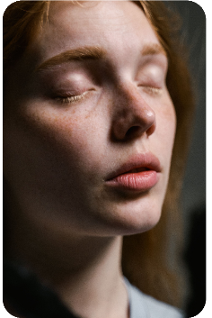
02 / SKIN + LOOK
Skin Types
Common Skin Types : Dry, oily, combination, normal, and sensitive skin
04 SENSITIVE SKIN
Keep the barrier happy
FEWER SURPRISES
Calm skin always wears makeup better.
Patch-test new products and keep ingredients familiar.
Choose gentle, fragrance-free prep when possible.
If skin burns or swells, stop and give it a break.
skin type can shift with climate, hormones, and stress. Re-check the basics every few months.
Skin may flush, sting, or react quickly to weather, fragrance, or new products. Redness is common and totally manageable.
Glow Beauty | Daily Inspiration Hubdaily | inspirationhub.com

Slide 13
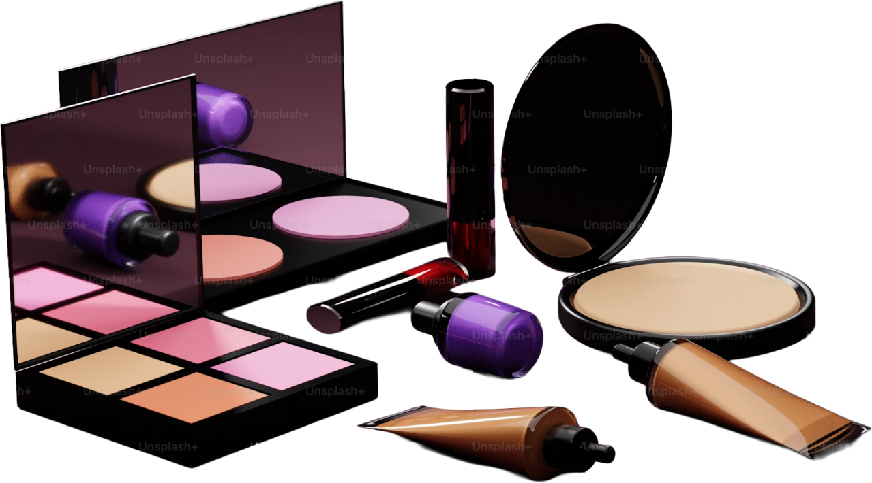
Makeup is a tool, not a mask.
PART THREE
Build the base
Good base is not about piling on product. It is about thin layers that sit still.
Glow Beauty | Daily Inspiration Hubdaily | inspirationhub.com

Slide 14
03 / Build the base
BUILD THE BASE
Five rules for a smoother, longer-wearing face
THE BASE DECIDES THE WHOLE LOOK
Treat foundation like a sheer veil—not wall paint.
01 Prep the surface
04 Set only where needed
01
04
Powder the T-zone and under-eyes; keep cheekbones alive.
Moisturizer + SPF give makeup something comfortable to grip.
02 Correct with color
05 Blend past the edge
02
05
Lavender can lift sallowness; green can soften visible redness.
Bring leftover product down the neck so there is no obvious line.
03 Match the center
The cheat code:
03
Match foundation to your jaw or neck—not the back of your hand.
thin layers + a little patience between them.
Glow Beauty | Daily Inspiration Hubdaily | inspirationhub.com

Slide 15
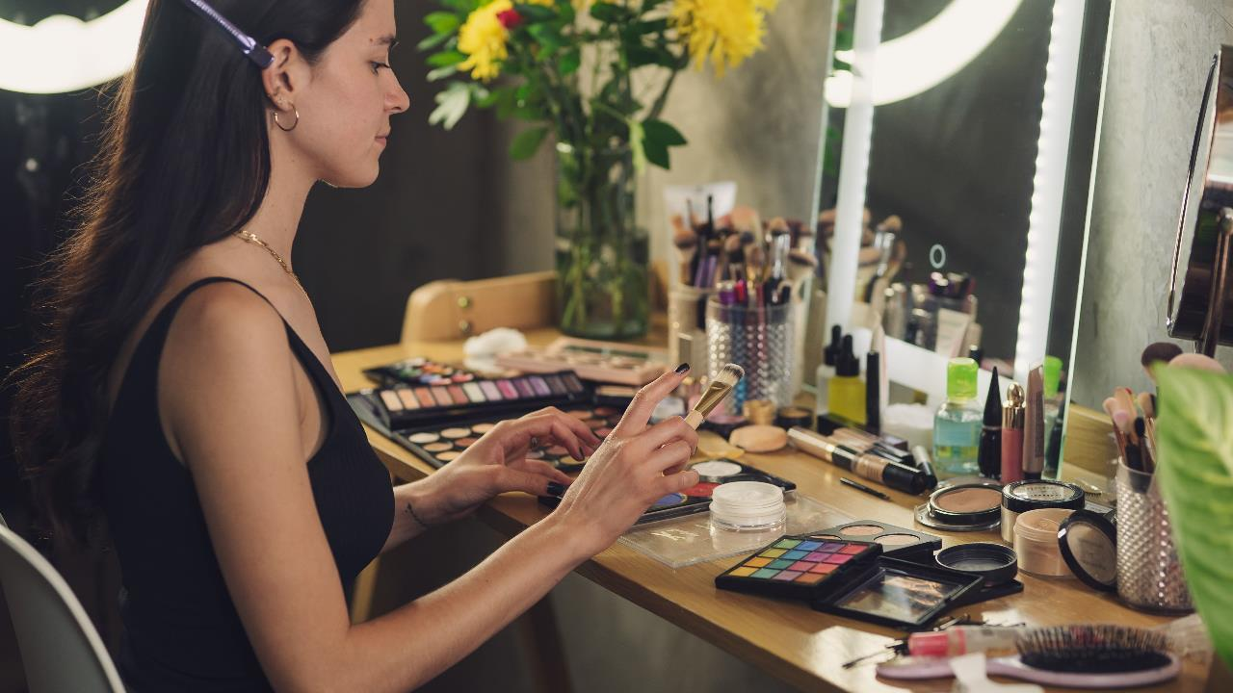
01 / Gentle Cleanser
02 / Moisturizer + SPF
03 / Skin Tint or Foundation
04 / Concealer
05 / Brow Pencil or Gel
06 / Mascara
07 / Neutral Eyeshadow
08 / Blush
09 / Lip Color
10 / One Fluffy Brush
Makeup is a tool, not a mask.
PART FOUR
BUILD MY KIT
You do not need a suitcase of products. You need a short list that earns its spot.
Patch-test new skincare and makeup when possible. People with highly sensitive skin, severe acne, or eye conditions should seek professional medical advice.
Glow Beauty | Daily Inspiration Hubdaily | inspirationhub.com

Slide 16

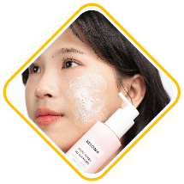
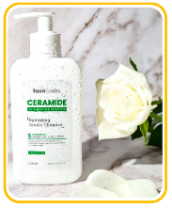
04 / Build MY KIT
THE BEGINNER KIT
Ten tools. Plenty of looks.
Start with the basics,
then add personality when you know what you reach for.
01 Gentle Cleanser
Purpose： Removes sweat, excess oil, sunscreen, and daily impurities while helping preserve the skin barrier.
How to use：Wet the face with lukewarm water, gently massage in a small amount for 30–60 seconds, then rinse thoroughly.
Tip： Dry or sensitive skin may only need water in the morning. Remove heavy makeup or water-resistant sunscreen before cleansing at night.
Caution：Avoid hot water, harsh scrubs, and cleansers that leave the skin feeling tight. Stop if persistent burning or redness occurs.
Watch out：Skip high-SLS formulas. Skin should not feel tight after washing.
Recommended brands：CeraVe、La Roche-Posay、Clinique
Glow Beauty | Daily Inspiration Hubdaily | inspirationhub.com

Slide 17

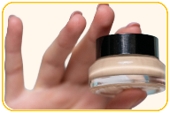
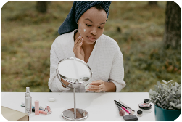
04 / Build MY KIT
THE BEGINNER KIT
Ten tools. Plenty of looks.
Start with the basics,
then add personality when you know what you reach for.
02 Moisturizer + SPF
Purpose： Moisturizer reduces water loss, while sunscreen helps prevent sunburn, pigmentation, and premature photoaging.
How to use：Apply a broad-spectrum SPF 30+ as the final morning skincare step. Use a generous amount on the face and neck and reapply about every two hours outdoors.
Tip： A moisturizer with SPF can simplify the routine. For dry skin, apply a regular moisturizer first and sunscreen afterward.
Caution：Do not rely on the small amount of SPF in foundation as your only sun protection. Reapply after sweating or swimming.
Watch out：Gel for oily skin, cream for dry. Use SPF 30+ as the last daytime step.
Recommended brands：La Roche-Posay、EltaMD、Eucerin
Glow Beauty | Daily Inspiration Hubdaily | inspirationhub.com

Slide 18
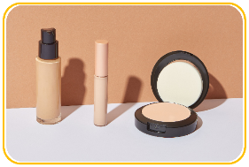
04 / Build MY KIT
THE BEGINNER KIT
Ten tools. Plenty of looks.
Start with the basics,
then add personality when you know what you reach for.
03 Skin Tint or Foundation
Purpose： Evens out the complexion and softens the appearance of redness or discoloration. Skin tint is usually lighter, while foundation offers more coverage.
How to use：Apply a small amount from the center of the face and blend outward with fingers, a sponge, or a foundation brush. Build coverage only where needed.
Tip： Test shades along the jawline and check them in natural light. Wait a few minutes to see whether the formula oxidizes darker.
Caution：Applying too much at once can look cakey or settle into lines. Oily skin may benefit from light setting powder, while dry skin should avoid excessive powder.
Watch out：Match to jaw or neck, not too light. Build in thin layers—sheer beats heavy.
Recommended brands：NARS、Estée Lauder、L’Oréal Paris
Glow Beauty | Daily Inspiration Hubdaily | inspirationhub.com

Slide 19

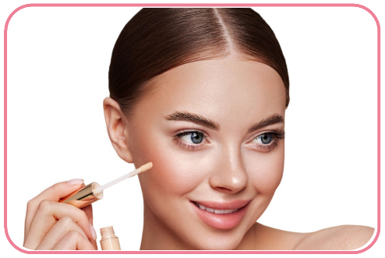
04 / Build MY KIT
THE BEGINNER KIT
Ten tools. Plenty of looks.
Start with the basics,
then add personality when you know what you reach for.
04 Concealer
Purpose： Provides targeted coverage for dark circles, blemishes,
redness, and small areas of discoloration.
How to use：Dot a small amount onto the target area, let it sit
briefly, then tap and blend the edges into the base.
Tip：Use a skin-matching shade for blemishes. Under the eyes,
choose a slightly brightening shade that is not dramatically lighter.
Caution：Too much product under the eyes can crease. Avoid repeatedly
touching the applicator directly to broken or inflamed blemishes.
Watch out：Under-eyes: half a shade lighter. Blemishes: match your
skin. Use little to avoid creasing.
Recommended brands：NARS、Tarte、Maybelline New York
Glow Beauty | Daily Inspiration Hubdaily | inspirationhub.com
Glow Beauty | Daily Inspiration Hubdaily | inspirationhub.com

Slide 20

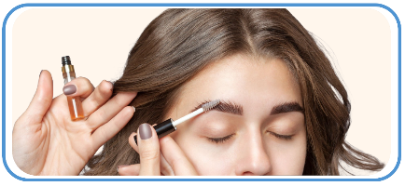
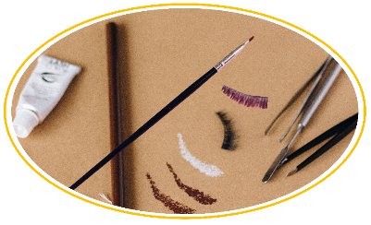
04 / Build MY KIT
THE BEGINNER KIT
Ten tools. Plenty of looks.
Start with the basics,
then add personality when you know what you reach for.
05 Brow Pencil or Gel
Purpose： Fills sparse areas, refines the brow shape, and holds brow hairs in place.
How to use：Draw short, light, hair-like strokes in the direction of growth, then soften them with a spoolie. Brush brow gel from the inner brow toward the tail.
Tip：Keep the inner brow soft and define the arch and tail slightly more. A shade close to or slightly lighter than the hair color often looks natural.
Caution：Avoid drawing a dark, block-shaped inner brow. Keep pencils sharpened and brow tools clean.
Watch out：Pick grey-brown or deep brown near your hair color—keep it natural, not drawn-on.
Recommended brands：Anastasia Beverly Hills、Benefit Cosmetics、NYX Professional Makeup
Glow Beauty | Daily Inspiration Hubdaily | inspirationhub.com

Slide 21

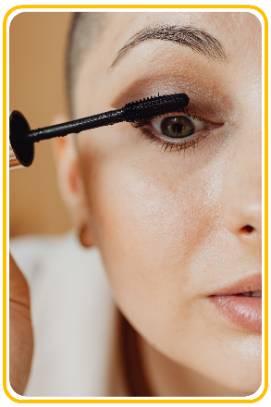
04 / Build MY KIT
THE BEGINNER KIT
Ten tools. Plenty of looks.
Start with the basics,
then add personality when you know what you reach for.
06 Mascara
Purpose： Darkens the lashes and adds length, curl, or volume.
How to use：Start at the roots, gently wiggle the wand side to side, and pull upward. Add a second coat after a brief pause if needed.
Tip：Curl lashes before applying mascara. If smudging is common, try a tubing or waterproof formula.
Caution：Never share mascara or pump the wand repeatedly, which introduces air and bacteria. Replace it if it smells unusual, dries out, or after roughly three months of use.
Watch out：Don't overcoat or it clumps. Remove with eye makeup remover—never tug.
Recommended brands：Lancôme、Benefit Cosmetics、Maybelline New York
Glow Beauty | Daily Inspiration Hubdaily | inspirationhub.com

Slide 22
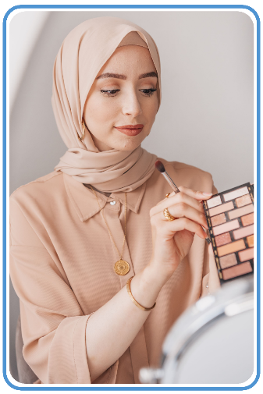
04 / Build MY KIT
THE BEGINNER KIT
Ten tools. Plenty of looks.
Start with the basics,
then add personality when you know what you reach for.
07 Neutral Eyeshadow
Purpose： Adds natural depth and dimension to the eyes. It works for subtle daytime makeup and can be built up for evening looks.
How to use：Apply a light shade over the lid, blend a mid-tone through the crease, and place a small amount of deeper color at the outer corner or lash line.
Tip：Beginners can start with matte beige, taupe, or soft brown. Pick up a little product at a time and blend the edges gradually.
Caution：Keep glitter particles out of the eyes. Stop using the product if irritation, infection, or an unusual odor develops.
Watch out：Start with earth tones. Build slowly and avoid hard edges.
Recommended brands：Urban Decay、Natasha Denona、e.l.f. Cosmetics
Glow Beauty | Daily Inspiration Hubdaily | inspirationhub.com

Slide 23

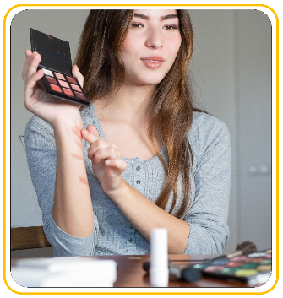
04 / Build MY KIT
THE BEGINNER KIT
Ten tools. Plenty of looks.
Start with the basics,
then add personality when you know what you reach for.
08 Blush
Purpose： Restores color to the complexion and can subtly shape the face depending on placement.
How to use：Apply a small amount to the apples or upper cheekbones and blend softly toward the temples.
Tip：Tap excess powder off the brush. For liquid or cream blush, adjust the amount on the back of the hand before tapping it onto the cheeks.
Caution：Highly pigmented formulas can be easy to overapply, so start with very little. Keep brushes clean, especially if the skin is acne-prone or sensitive.
Watch out：Less is more. Keep placement above the nostrils or it drags the face down.
Recommended brands：NARS、Rare Beauty、Milani
Glow Beauty | Daily Inspiration Hubdaily | inspirationhub.com

Slide 24

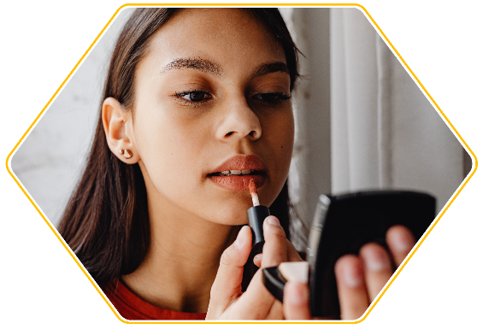
04 / Build MY KIT
THE BEGINNER KIT
Ten tools. Plenty of looks.
Start with the basics,
then add personality when you know what you reach for.
09 Lip color
Purpose： Adds color, shine, or definition to the lips, including tinted balms, lipsticks, liquid lip colors, and glosses.
How to use：Apply lip balm first and blot away excess, then work from the center of the lips outward. Use lip liner when a more defined edge is desired.
Tip：Beginners can try rose, muted pink-brown, or soft nude shades close to their natural lip color. One shade can look different when applied sheer or layered.
Caution：Do not share lip products. Pause use on cracked lips or during a cold-sore outbreak. Some long-wear formulas can be drying.
Watch out：Prep with balm first. Pair strong reds with a lip liner.
Recommended brands：MAC Cosmetics、Charlotte Tilbury、Dior
Glow Beauty | Daily Inspiration Hubdaily | inspirationhub.com

Slide 25

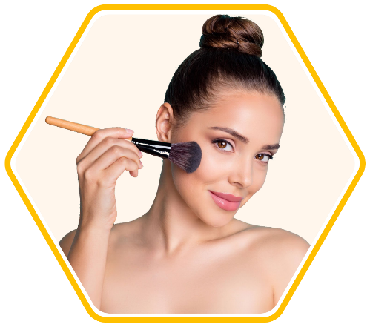
04 / Build MY KIT
THE BEGINNER KIT
Ten tools. Plenty of looks.
Start with the basics,
then add personality when you know what you reach for.
10 One Fluffy Brush
Purpose： Can apply setting powder, blush, or bronzer; a smaller fluffy brush can also blend eyeshadow.
How to use：Pick up a small amount, tap off the excess, then apply with sweeping, circular, or pressing motions.
Tip：A medium-sized, softly tapered synthetic brush is versatile and easier to control than an oversized brush.
Caution：Clean the brush before switching between dark and light colors or between eye and face products. Wash weekly or as needed and dry it flat so water does not enter the ferrule.
Watch out：Start with earth tones. Build slowly and avoid hard edges.
Recommended brands：Real Techniques、Sigma Beauty、Sephora Collection
Glow Beauty | Daily Inspiration Hubdaily | inspirationhub.com

Slide 26
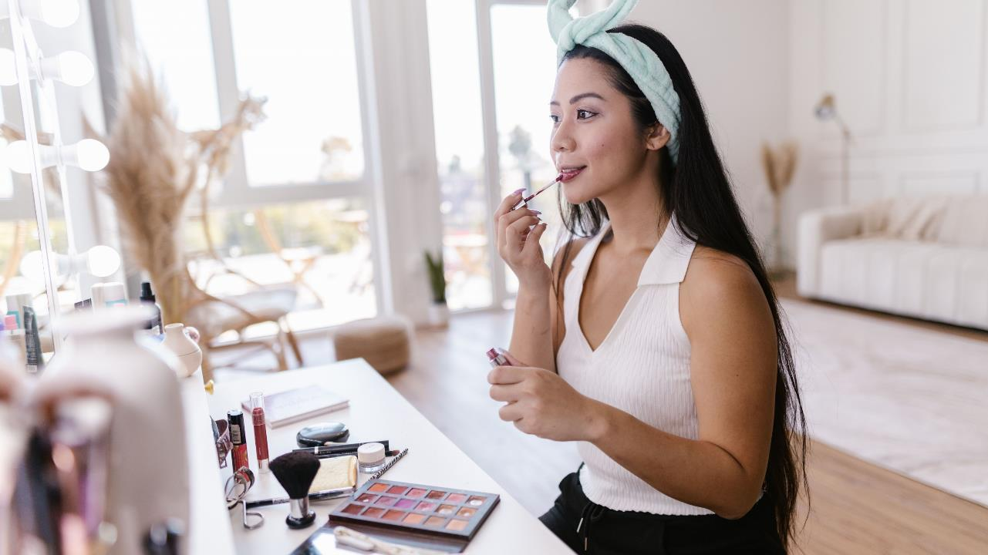
Healthy skin first. Makeup second.
PART FIVE
Skin prep
Simple skin care helps makeup sit better. Keep it gentle, steady, and easy.
Keep it simple.
AM: cleanse, moisturize, protect.
PM: remove, cleanse, moisturize.
Glow Beauty | Daily Inspiration Hubdaily | inspirationhub.com

Slide 27

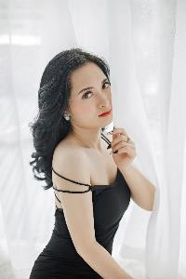
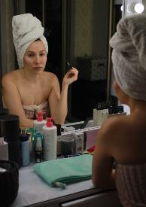
05 / SKIN PREP
Protect AM, reset PM
MORNING / NIGHT
THE ROUTINE THAT MAKES MAKEUP BEHAVE
Cleanse, hydrate, protect, then stop.
MORNING
Wake up and protect
01 Gentle cleanse or rinse
02 Hydrate if needed, then moisturize
03 SPF 30+ / Broad-spectrum SPF 30+
04 Give it a few minutes, then do makeup
MORNING
Wake up and protect
NIGHT
Take the day off
01 Break down makeup and sunscreen
02 Follow with a gentle cleanse
03 Treat if needed, then moisturize
04 Skip harsh scrubbing
NIGHT
Take the day off
Cool or lukewarm water is fine. Gentle cleansing matters more than the temperature.
Glow Beauty | Daily Inspiration Hubdaily | inspirationhub.com

Slide 28
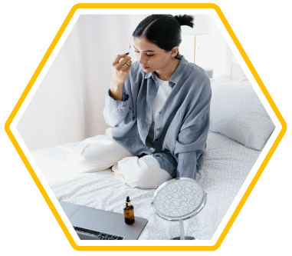
05 / SKIN PREP
Your six-minute AM routine
MORNING
Keep layers light and give each one a moment to settle.
six-minute
Cleanse
Hydrate
Eye care
Moisturize
Protect
Wait
Ready for makeup
Cleanse
Rinse or wash gently
for 30-60 sec.
Moisturize
Use a thin layer; add more on dry spots.
01
04
Hydrate
Toner or serum,
only if you need it.
Protect
SPF 30+ over face, ears, and neck.
02
05
Eye care
Optional; a rice-grain
amount is plenty.
Wait
Wait 5-10 minutes before makeup.
03
06
Go thin to thick: sunscreen is always the last AM skin-care step.
Glow Beauty | Daily Inspiration Hubdaily | inspirationhub.com

Slide 29
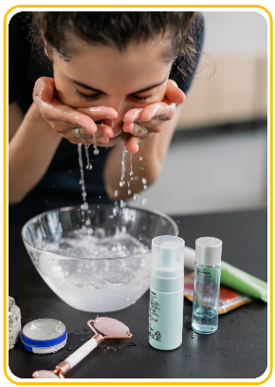
05 / SKIN PREP
Your six-minute AM routine
MORNING
Keep layers light and give each one a moment to settle.
six-minute
Cleanse
Hydrate
Eye care
Moisturize
Protect
Wait
Ready for makeup
01 Cleanse gently
You are clearing sweat and oil, not scrubbing your face squeaky-clean.
PRODUCT + HOW
Use a cream or low-foam cleanser.
Massage 30-60 sec, then rinse.
Dry or sensitive skin can just rinse.
Result: clean and comfortable, never tight.
Use cool or lukewarm water, pat dry,
and skip hot water or scrub brushes.
Glow Beauty | Daily Inspiration Hubdaily | inspirationhub.com

Slide 30
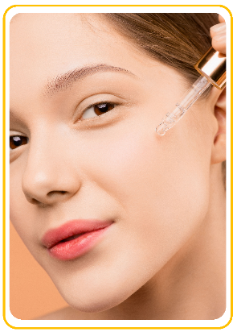
05 / SKIN PREP
Your six-minute AM routine
MORNING
Keep layers light and give each one a moment to settle.
six-minute
Cleanse
Hydrate
Eye care
Moisturize
Protect
Wait
Ready for makeup
02 Hydration is optional
If moisturizer already feels good, you can skip this step. More layers are not automatically better.
PRODUCT + HOW
Try an alcohol-free toner or basic hydrating serum.
Press 2-3 drops into slightly damp skin.
Look for glycerin or hyaluronic acid.
Result: plump and lightly dewy, not sticky.
TIP:
Wait 30-60 sec before moisturizer. If it pills, use less or skip it.
Glow Beauty | Daily Inspiration Hubdaily | inspirationhub.com

Slide 31
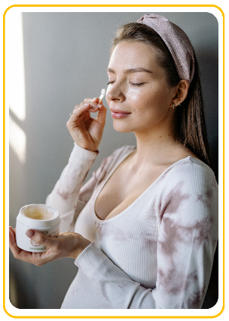
05 / SKIN PREP
Your six-minute AM routine
MORNING
Keep layers light and give each one a moment to settle.
six-minute
Cleanse
Hydrate
Eye care
Moisturize
Protect
Wait
Ready for makeup
03 Eye cream is optional
A plain moisturizer can work around the eyes if it feels comfortable and does not sting.
PRODUCT + HOW
Use a light, fragrance-free eye cream or moisturizer.
Use one rice-grain amount for both eyes; tap on the orbital bone.
Stay off the lash line and never tug.
Result: soft and comfortable, with no greasy film.
Note:
Stop if it stings, waters, or causes bumps. Less is usually better.
Glow Beauty | Daily Inspiration Hubdaily | inspirationhub.com

Slide 32
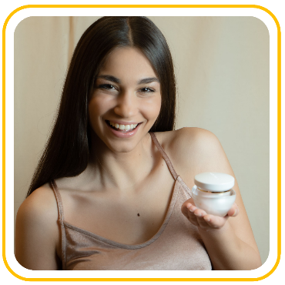
05 / SKIN PREP
Your six-minute AM routine
MORNING
Keep layers light and give each one a moment to settle.
six-minute
Cleanse
Hydrate
Eye care
Moisturize
Protect
Wait
Ready for makeup
04 Moisturize for comfort
This is the step that smooths dry texture and gives makeup a calmer surface.
PRODUCT + HOW
Oily skin: gel-lotion. Dry skin: cream.
Press a pea-size amount onto slightly damp skin.
Add more on cheeks and less through the T-zone.
Result: soft and cushioned, not slippery.
TIP:
If it pills, cut back on toner, serum, or moisturizer instead of adding more.
Glow Beauty | Daily Inspiration Hubdaily | inspirationhub.com

Slide 33
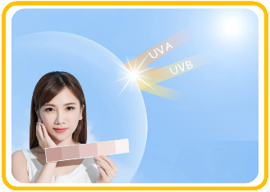
05 / SKIN PREP
Your six-minute AM routine
MORNING
Keep layers light and give each one a moment to settle.
six-minute
Cleanse
Hydrate
Eye care
Moisturize
Protect
Wait
Ready for makeup
05 Sunscreen goes last
Use broad-spectrum SPF 30+ every morning. It protects the skin prep you just did.
PRODUCT + HOW
Cover face, hairline, ears, and neck evenly.
Apply in two thin passes and blend every edge.
Reapply about every 2 hours outdoors and after swimming or sweating.
Result: even protection with a settled, light finish.
Waiting…
Wait 5-10 minutes. Use water-resistant SPF for sweat; foundation SPF is not enough on its own.
Glow Beauty | Daily Inspiration Hubdaily | inspirationhub.com

Slide 34
05 / SKIN PREP
Your six-minute AM routine
MORNING
Keep layers light and give each one a moment to settle.
six-minute
Cleanse
Hydrate
Eye care
Moisturize
Protect
Wait
Ready for makeup
Soft, not slick
Good prep feels calm and settled. You should not see a wet layer sitting on top.
No sting
No burning or fresh redness.
No pull
Skin does not pull when you smile.
01
02
No slip
No heavy film under your fingertip.
Edges covered
SPF reaches hairline, ears, and neck.
03
04
No pilling
Nothing rolls up when you tap.
05
Final effect:
foundation spreads more easily and looks less patchy.
Glow Beauty | Daily Inspiration Hubdaily | inspirationhub.com

Slide 35
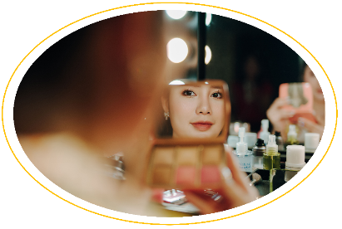
05 / SKIN PREP
Your simple PM reset
NIGHT ROUTINE
Double-cleanse only for makeup or heavy SPF.
Break it down Use oil, balm, or micellar water first.
Treat
Pick one serum only if you need it.
01
04
Rinse
Emulsify oil or balm, then rinse.
Eye care
Optional; tap, never tug.
02
05
Cleanse
Cleanse gently for 30-60 sec.
03
06
Seal
Finish with moisturizer.
PM goal:
remove the day, cleanse gently, and bring back comfort.
Glow Beauty | Daily Inspiration Hubdaily | inspirationhub.com

Slide 36
05 / SKIN PREP
Your simple PM reset
NIGHT ROUTINE
Double-cleanse only for makeup or heavy SPF.
01 Break makeup down first
Break it down
Cleanse
Pick One
Finish
Optional extras
Do not make your cleanser fight waterproof mascara, long-wear base, and sunscreen all at once.
PRODUCT + HOW
Use cleansing oil, balm, or micellar water.
Oil or balm: massage dry, add water, then emulsify.
Eyes and lips: hold, then wipe gently; do not rub.
Result: makeup is loosened without tugging.
Note:
If micellar water leaves a film, rinse and follow with a gentle cleanser.
Glow Beauty | Daily Inspiration Hubdaily | inspirationhub.com

Slide 37
05 / SKIN PREP
Your simple PM reset
NIGHT ROUTINE
Double-cleanse only for makeup or heavy SPF.
02 Cleanse gently again
Break it down
Cleanse
Pick One
Finish
Optional extras
This step removes leftover remover, sweat, and daily grime. It should not leave your face squeaky.
PRODUCT + HOW
Use a low-foam gel or cream cleanser.
Massage 30-60 sec and rinse well.
Skip scrubs, cleansing brushes, and hot water.
Result: clean and soft, with no residue at hairline or nose.
If skin feels tight right away, shorten the wash and try a gentler formula.
Glow Beauty | Daily Inspiration Hubdaily | inspirationhub.com

Slide 38
05 / SKIN PREP
Your simple PM reset
NIGHT ROUTINE
Double-cleanse only for makeup or heavy SPF.
03 Pick one treatment
Break it down
Cleanse
Pick One
Finish
Optional extras
Beginners do better with one simple goal: hydrate, calm, or treat. Do not stack everything in the cabinet.
PRODUCT + HOW
Hydrate with toner or a simple serum, 2-3 drops.
Eye cream is optional; tap on a rice-grain amount.
Add one active at a time and patch-test first.
Result: comfortable skin without a sticky stack of layers.
Note:
If skin burns, heats up, peels, or stays red, pause new products and return to cleanser plus moisturizer.
Glow Beauty | Daily Inspiration Hubdaily | inspirationhub.com

Slide 39
05 / SKIN PREP
Your simple PM reset
NIGHT ROUTINE
Double-cleanse only for makeup or heavy SPF.
04 Finish with moisturizer
Break it down
Cleanse
Pick One
Finish
Optional extras
Night moisturizer replaces comfort after cleansing and helps the skin feel steady by morning.
PRODUCT + HOW
Oily skin: light lotion. Dry skin: cream or barrier cream.
Press a pea-to-dime-size amount over the face.
Add a thin second layer only on dry spots.
Result: comfortable at bedtime and not parched by morning.
Heavy sealing is not required every night. If it feels itchy or congested, use less or go lighter.
Glow Beauty | Daily Inspiration Hubdaily | inspirationhub.com

Slide 40
05 / SKIN PREP
Basics first, extras later
NIGHT ROUTINE
Double-cleanse only for makeup or heavy SPF.
For two weeks: cleanser, moisturizer, SPF.
Break it down
Cleanse
Pick One
Finish
Optional extras
One only
Introduce one product, then watch your skin.
Go easy
If you use one, start around once weekly.
01
02
Optional
Hydrating masks give temporary comfort.
Don't stack
Try unfamiliar acids or retinoids separately.
03
04
Stop
Stop when skin burns, peels, or swells.
05
Beginner rule:
steady beats intense, and consistent beats complicated.
Glow Beauty | Daily Inspiration Hubdaily | inspirationhub.com

Slide 41

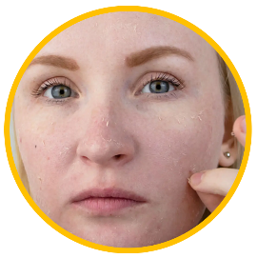
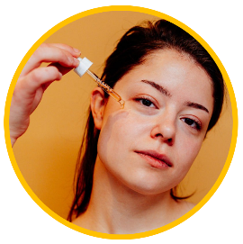
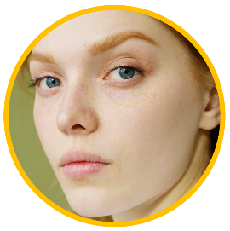
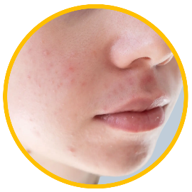
05 / SKIN PREP
Match texture to skin
ADJUST, DON'T RESTART
Same order; adjust texture and amount.
Skin shifts with weather and stress. Adjust to how it feels, not a permanent label.
01
DRY
Creamy, cushioned, comfortable
Cream cleanser + hydrating serum + cream.
02
OILY
Light, fresh, never stripped
Gentle gel cleanser + light lotion.
03
COMBINATION
Zone by zone
Use less on the T-zone, more on cheeks.
04
SENSITIVE
Simple and fragrance-free
Patch-test and add one product at a time.
Glow Beauty | Daily Inspiration Hubdaily | inspirationhub.com

Slide 42
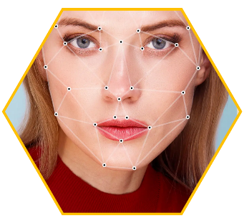
05 / SKIN PREP
Check these five first
COMMON MISTAKES
Most problems come from heat, rubbing, excess, or no wait.
Switch to cool or lukewarm water.
Water too hot
01
Makeup too soon
05
02
Too many layers
Wait 5-10 minutes after sunscreen.
Toner and serum can be skipped.
Too little SPF
04
03
Too much rubbing
Cover face, ears, hairline, and neck..
Press and tap instead.
Pilling fix:
stop rubbing, press with a clean damp sponge, then redo only the patch if needed.
Glow Beauty | Daily Inspiration Hubdaily | inspirationhub.com

Slide 43
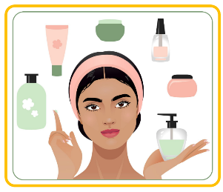
05 / SKIN PREP
The beginner skin kit
THE BEGINNER SKIN KIT
Most problems come from heat, rubbing, excess, or no wait.
Ten is plenty
Start with four basics; add extras only when needed.
01 Gentle cleanser
06 Serum (optional)
02 Makeup remover
07 Eye cream (optional)
03 Moisturizer
08 Lip balm
04 SPF 30+ / Broad-spectrum SPF
09 Soft face cloth
05 Toner (optional)
10 Clean towel
Master four first: cleanser, remover, moisturizer, sunscreen.
Glow Beauty | Daily Inspiration Hubdaily | inspirationhub.com

Slide 44
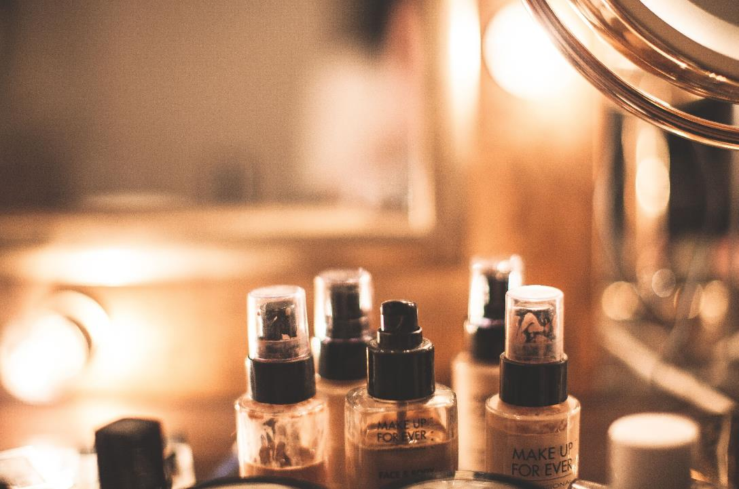
05 / SKIN PREP
The beginner skin kit
THE BEGINNER SKIN KIT
Most problems come from heat, rubbing, excess, or no wait.
Examples, not must - buys
Choose by feel and budget; formulas change.
The best product is the one your skin likes and you will actually use.
01 Cleanser: CeraVe · Vanicream
06 Eye: CeraVe · Clinique
02 Balm: Clinique · e.l.f.
07 Light: CeraVe · Neutrogena
03 Micellar: Bioderma · Garnier
08 Rich: Eucerin · CeraVe
04 Toner: Clinique · Pixi
09 SPF: EltaMD · Supergoop
05 Serum: The Ordinary · Vichy
10 SPF: Avène · Eucerin
Glow Beauty | Daily Inspiration Hubdaily | inspirationhub.com

Slide 45
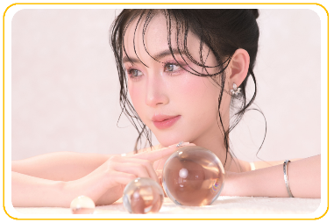
05 / SKIN PREP
What good prep feels like
THE FINISH
AM: cleanse, moisturize, protect. PM: remove, cleanse, moisturize.
Good prep does not make skin perfect. It makes skin comfortable, predictable, and easier to work with.
LOOK FOR THIS
Right away: clean, calm, and not tight.
With makeup: base spreads easier and catches less.
Over 2-4 weeks: skin feels more consistent and predictable.
Note:
For ongoing burning, swelling, heavy peeling, or severe breakouts, stop new products and see a dermatologist.
Success is not maximum glow; it is comfort, consistency, and a routine you will keep.
Glow Beauty | Daily Inspiration Hubdaily | inspirationhub.com

